Slide 1
Week 9 reading CVC and Dolch list words in sentences
Ideally, prior to showing these slides, print the slides and cut up the sentences and pictures. Ask the learners in groups to match them, then work through the slides and ask learners to correct as you go along.
The following sentences incorporate Dolch words and CVC words. Work slowly with the group, showing how to sound out the new CVC words and draw attention to the Dolch words than can’t be sounded out. Use comprehension questions as you present each slide and model new language.
Use the arrows on the keyboard to move forward or click the buttons. Press F5 on the keyboard to start the slideshow.
end show

Slide 2
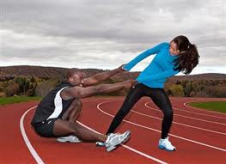
Bob and Pam are fit.
1

Slide 3
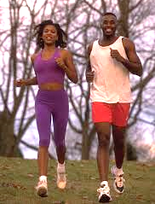
They run outside.
2

Slide 4
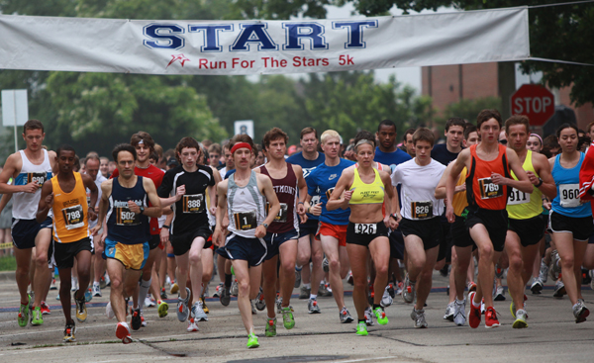
They ran in a race.
3

Slide 5
Pam must be tired.
4

Slide 6
5
Please can we stop?

Slide 7
6
No, keep running.

Slide 8
7
We can win the race.

Slide 9
Pam is in pain.
8

Slide 10
Her feet hurt.
9

Slide 11
Bob wins the race.
10

Slide 12
start again (if needed)
end show
slide 1

