Slide 1
Week 7 reading CVC and Dolch list words in sentences
Ideally, prior to showing these slides, print the slides and cut up the sentences and pictures. Ask the learners in groups to match them, then work through the slides and ask learners to correct as you go along.
The following sentences incorporate Dolch words and CVC words. Work slowly with the group, showing how to sound out the new CVC words and draw attention to the Dolch words than can’t be sounded out. Use comprehension questions as you present each slide and model new language.
Use the arrows on the keyboard to move forward or click the buttons. Press F5 on the keyboard to start the slideshow.
end show

Slide 2
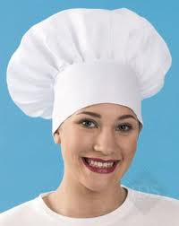
My name is Pat.
1

Slide 3
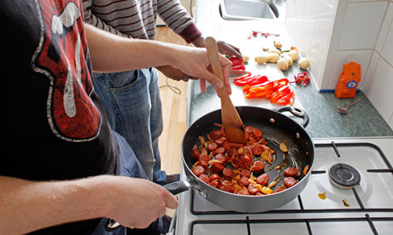
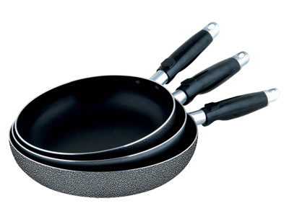
I cook with pans.
2

Slide 4
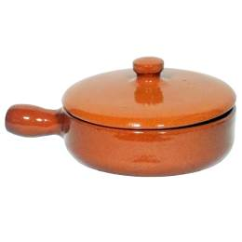
A brown pan.
3

Slide 5
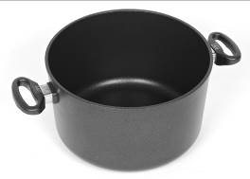
A black pan.
4

Slide 6
A tap for water.
5

Slide 7
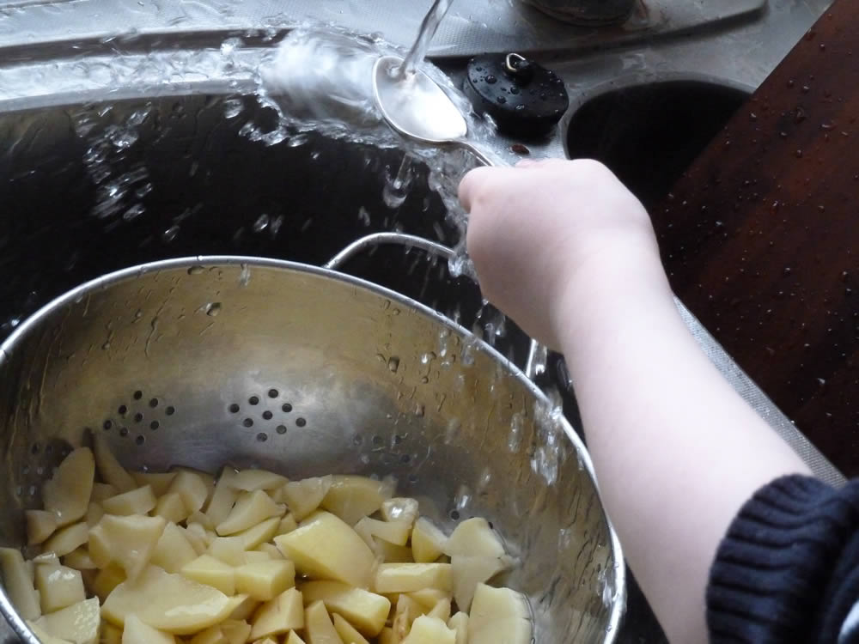
Water to cook.
6

Slide 8
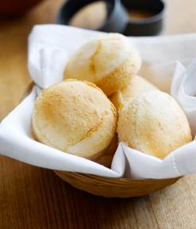
I make bread baps.
7

Slide 9
I wear a cap.
8

Slide 10
I cook in a cap.
9

Slide 11
Then I have a nap.
10

Slide 12
start again (if needed)
end show
slide 1

