Slide 1
Week 6 reading CVC and Dolch list words in sentences
Ideally, prior to showing these slides, print the slides and cut up the sentences and pictures. Ask the learners in groups to match them, then work through the slides and ask learners to correct as you go along.
The following sentences incorporate Dolch words and CVC words. Work slowly with the group, showing how to sound out the new CVC words and draw attention to the Dolch words than can’t be sounded out. Use comprehension questions as you present each slide and model new language.
Use the arrows on the keyboard to move forward or click the buttons. Press F5 on the keyboard to start the slideshow.
end show

Slide 2
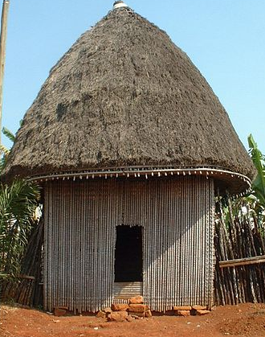
One brown hut.
1
Notes:
Adjective + common noun
http://commons.wikimedia.org/wiki/File:Case_%C3%A0_la_chefferie_de_Bana.jpg

Slide 3
Three huts.
2
Notes:
Adjective + noun
Hut = http://commons.wikimedia.org/wiki/File:Case_%C3%A0_la_chefferie_de_Bana.jpg

Slide 4
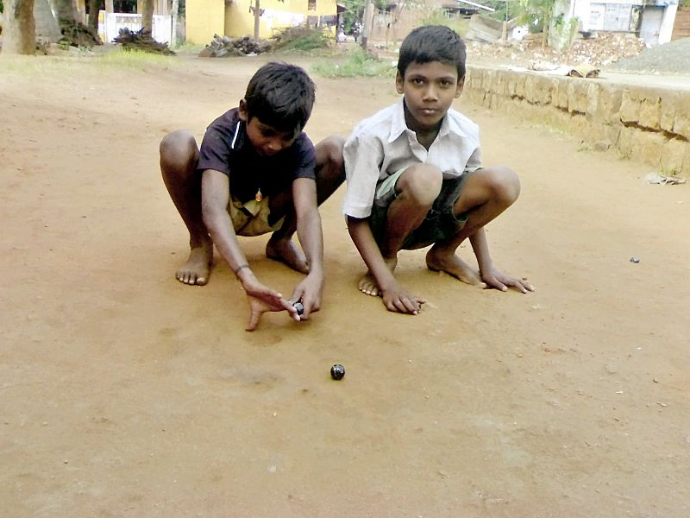
The children go to the hut!
3
Notes:
Infinitive verb + preposition + definite article + common noun
Person = http://commons.wikimedia.org/wiki/File:Animated-runner.svg
Hut = http://commons.wikimedia.org/wiki/File:Case_%C3%A0_la_chefferie_de_Bana.jpg

Slide 5
We play at the hut
4
Notes:
Pronoun + infinitive verb + preposition + definite article + common noun
hut = http://commons.wikimedia.org/wiki/File:Case_%C3%A0_la_chefferie_de_Bana.jpg
Playing = http://commons.wikimedia.org/wiki/File:A_boy_playing_one_of_a_Street_Games_of_Tamil_Nadu_-_Kozhi_Gundu_2.jpg

Slide 6
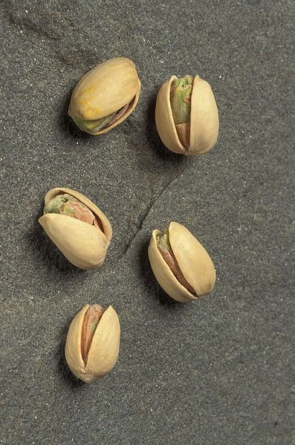
A hut and nuts.
5
Notes:
Indefinite article + common noun + conjunction + common noun
Hut = http://commons.wikimedia.org/wiki/File:Case_%C3%A0_la_chefferie_de_Bana.jpg
Nuts = http://commons.wikimedia.org/wiki/File:ARS_pistachio.jpg

Slide 7
Three nuts.
6
Notes:
Adjective + common noun
Nuts = http://commons.wikimedia.org/wiki/File:ARS_pistachio.jpg

Slide 8
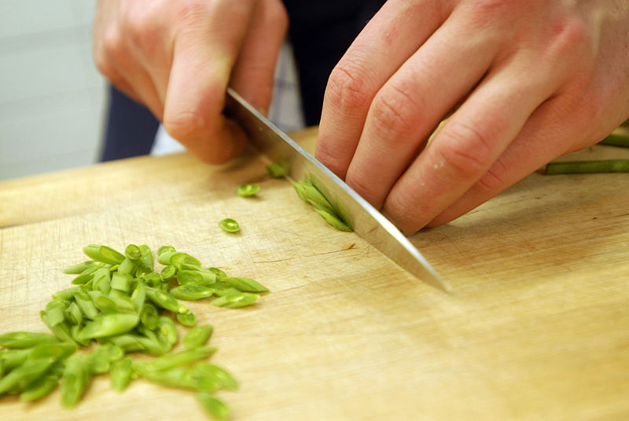
Cut up!
8
Notes:
Infinitive verb + preposition
Cutting = http://commons.wikimedia.org/wiki/File:Matlagning.jpg

Slide 9
Cut up the nuts.
7
Notes:
Infinitive verb + preposition + definite article + common noun
Cutting = http://commons.wikimedia.org/wiki/File:Matlagning.jpg
Nuts = http://commons.wikimedia.org/wiki/File:ARS_pistachio.jpg

Slide 10
Where are the nuts?
9
Notes:
Interrogative pronoun + infinitive verb + definite article + common noun
Hut = http://commons.wikimedia.org/wiki/File:Case_%C3%A0_la_chefferie_de_Bana.jpg
Nuts = http://commons.wikimedia.org/wiki/File:ARS_pistachio.jpg
Cutting = http://commons.wikimedia.org/wiki/File:Matlagning.jpg

Slide 11
start again (if needed)
end show
slide 1

