Slide 1
Week 6 reading CVC and Dolch list words in sentences
Ideally, prior to showing these slides, print the slides and cut up the sentences and pictures. Ask the learners in groups to match them, then work through the slides and ask learners to correct as you go along.
The following sentences incorporate Dolch words and CVC words. Work slowly with the group, showing how to sound out the new CVC words and draw attention to the Dolch words than can’t be sounded out. Use comprehension questions as you present each slide and model new language.
Use the arrows on the keyboard to move forward or click the buttons. Press F5 on the keyboard to start the slideshow.
end show

Slide 2
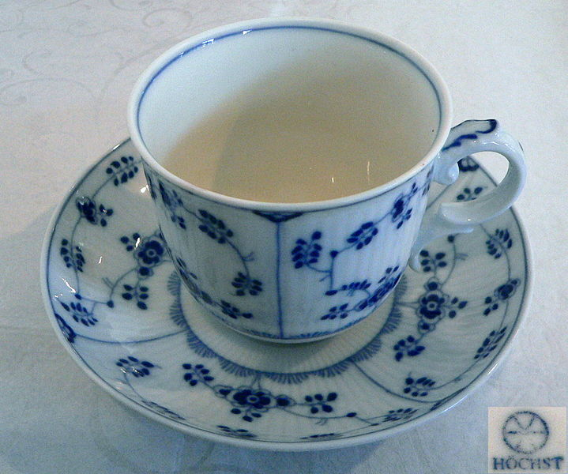
A cup for dad.
1
Notes:
Indefinite article + common noun
Cup = http://commons.wikimedia.org/wiki/File:H%C3%B6chster_Porzellan.JPG

Slide 3
A mug for mum.
2
Notes:
Indefinite article + common noun
Mug =http://commons.wikimedia.org/wiki/File:Hairymnstr_Coffee_Mug.svg

Slide 4
Where is the cup?
3
Notes:
Interrogative pronoun + present simple verb + definite article + common noun
Cup = http://commons.wikimedia.org/wiki/File:H%C3%B6chster_Porzellan.JPG
Mug =http://commons.wikimedia.org/wiki/File:Hairymnstr_Coffee_Mug.svg

Slide 5
Three cups.
4
Notes:
Adjective + common noun
Cup = http://commons.wikimedia.org/wiki/File:H%C3%B6chster_Porzellan.JPG

Slide 6
One jug for mum.
5
Notes:
Adjective + common noun
Jug = http://commons.wikimedia.org/wiki/File:Irish_pottery_jug.jpg

Slide 7
A cup and a jug.
6
Notes:
Indefinite article + common noun + conjunction + indefinite article + common noun
Cup = http://commons.wikimedia.org/wiki/File:H%C3%B6chster_Porzellan.JPG
Jug = http://commons.wikimedia.org/wiki/File:Irish_pottery_jug.jpg

Slide 8
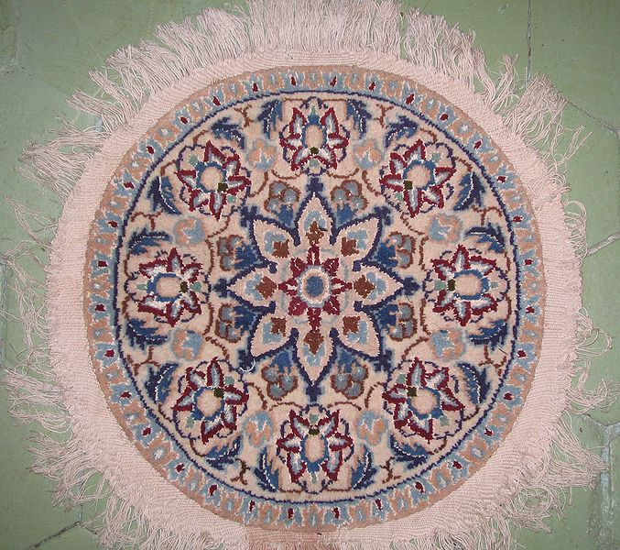
See the rug!
7
Notes:
Infinitive verb + definite article + common noun
See = http://commons.wikimedia.org/wiki/File:SEE!.jpg
Rug = http://commons.wikimedia.org/wiki/File:Nain_rug.jpg

Slide 9
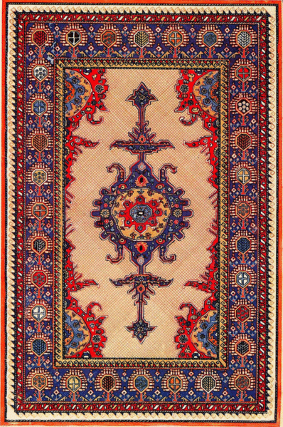
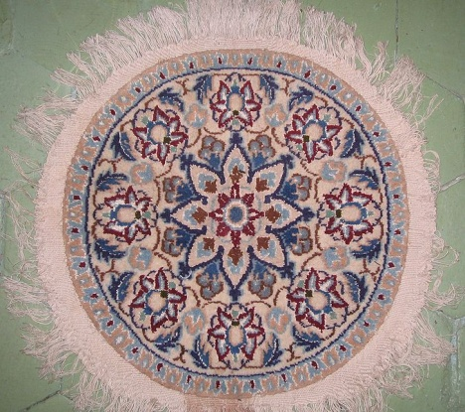
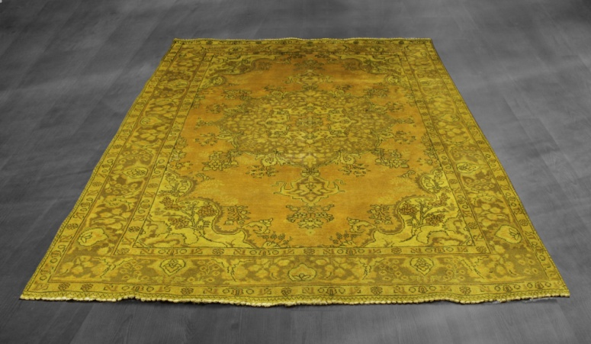
Find the yellow rug.
8
Notes:
Infinitive verb + definite article + noun + noun
Yellow rug = google images
Circular rug = http://commons.wikimedia.org/wiki/File:Nain_rug.jpg
Rectangular rug = http://commons.wikimedia.org/wiki/File:Gimil_rug.gif

Slide 10
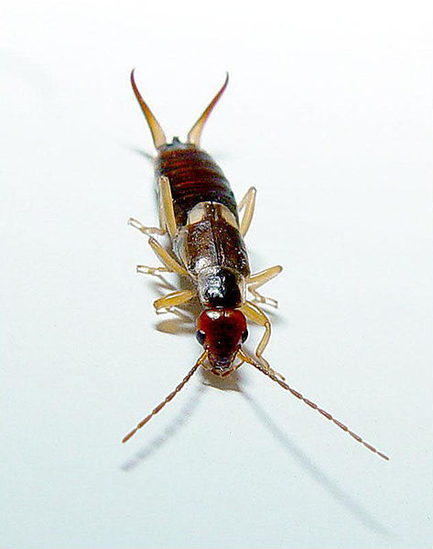
A bug.
9
Notes:
Indefinite article + common noun
Bug = http://commons.wikimedia.org/wiki/File:Forficula_auricularia.jpg

Slide 11
A bug on a yellow rug.
10
Notes:
Indefinite article + common noun + preposition + indefinite article + noun + noun
Bug = http://commons.wikimedia.org/wiki/File:Forficula_auricularia.jpg
Yellow rug = google images

Slide 12
start again (if needed)
end show
slide 1

