Slide 1
Week 5 reading CVC and Dolch list words in sentences
Ideally, prior to showing these slides, print the slides and cut up the sentences and pictures. Ask the learners in groups to match them, then work through the slides and ask learners to correct as you go along.
The following sentences incorporate Dolch words and CVC words. Work slowly with the group, showing how to sound out the new CVC words and draw attention to the Dolch words than can’t be sounded out. Use comprehension questions as you present each slide and model new language.
Use the arrows on the keyboard to move forward or click the buttons. Press F5 on the keyboard to start the slideshow.
end show

Slide 2
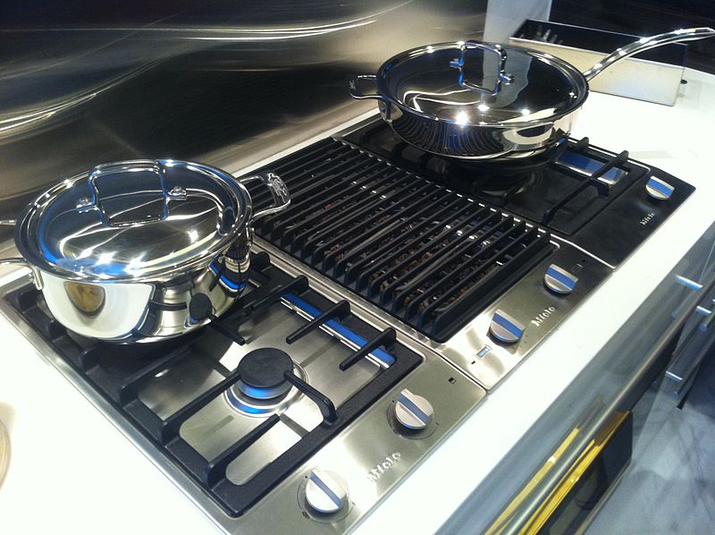
One hob.
1
Notes:
Adjective + common noun
Hob=http://commons.wikimedia.org/wiki/File:HK_Ka_Wah_Centre_showflat_%E6%B7%B1%E7%81%A39_Marinella_T6-A_Meile_Gas_Cooking_Hob_Oct-2011.jpg?uselang=en-gb

Slide 3
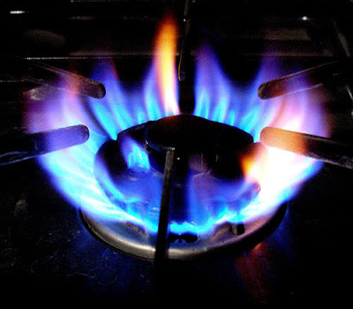
A hot hob.
2
Notes:
Indefinite article + adjective + noun
Hob=http://commons.wikimedia.org/wiki/File:HK_Ka_Wah_Centre_showflat_%E6%B7%B1%E7%81%A39_Marinella_T6-A_Meile_Gas_Cooking_Hob_Oct-2011.jpg?uselang=en-gb
Flame = google images

Slide 4
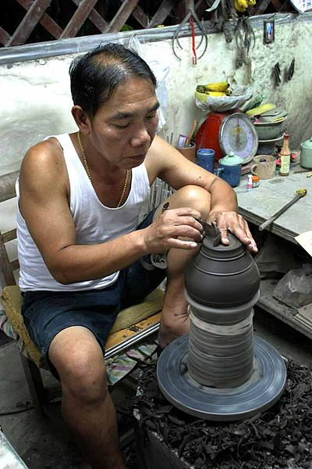
Make a pot
3
Notes:
Infinitive verb + indefinite article + common noun
Thai potter = http://commons.wikimedia.org/wiki/File:Thailand_Potter_(667392581).jpg

Slide 5
Two pots and a hob.
4
Notes:
Adjective + common noun + conjunction + indefinite article + common noun
Pot = http://commons.wikimedia.org/wiki/File:Thailand_Potter_(667392581).jpg
Hob = http://commons.wikimedia.org/wiki/File:HK_Ka_Wah_Centre_showflat_%E6%B7%B1%E7%81%A39_Marinella_T6-A_Meile_Gas_Cooking_Hob_Oct-2011.jpg?uselang=en-gb

Slide 6
A brown pot.
5
Notes:
Indefinite article + noun + noun
Brown coffee pot = http://commons.wikimedia.org/wiki/File:Cafeti%C3%A8re_%C3%A0_percolation_en_fa%C3%AFence_brune_01.jpg

Slide 7
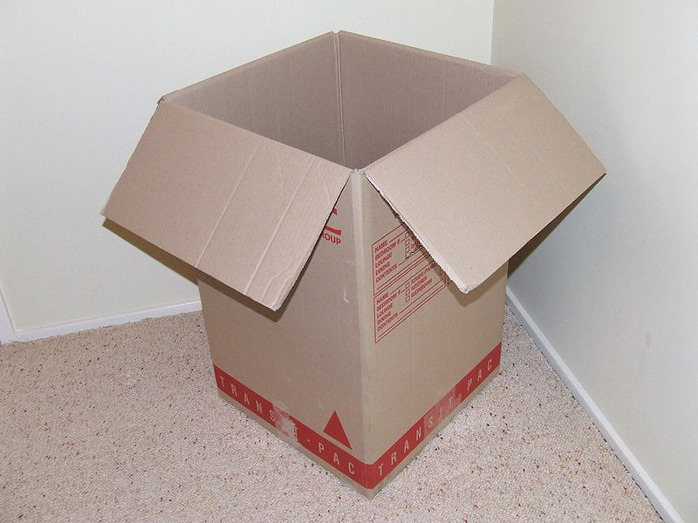
A box.
6
Notes:
Indefinite article + common noun
Box = http://commons.wikimedia.org/wiki/File:MOVINGBOX.JPG

Slide 8
A little box.
7
Notes:
Indefinite article + adjective + common noun
Box = http://commons.wikimedia.org/wiki/File:MOVINGBOX.JPG

Slide 9
The top of the box.
8
Notes:
Indefinite article + noun + preposition + definite article + common noun
Box = http://commons.wikimedia.org/wiki/File:MOVINGBOX.JPG

Slide 10
Lots of boxes.
9
Notes:
Noun + preposition + common noun
Box = http://commons.wikimedia.org/wiki/File:MOVINGBOX.JPG

Slide 11
start again (if needed)
end show
slide 1

