Slide 1
Week 5 reading CVC and Dolch list words in sentences
Ideally, prior to showing these slides, print the slides and cut up the sentences and pictures. Ask the learners in groups to match them, then work through the slides and ask learners to correct as you go along.
The following sentences incorporate Dolch words and CVC words. Work slowly with the group, showing how to sound out the new CVC words and draw attention to the Dolch words than can’t be sounded out. Use comprehension questions as you present each slide and model new language.
Use the arrows on the keyboard to move forward or click the buttons. Press F5 on the keyboard to start the slideshow.
end show

Slide 2
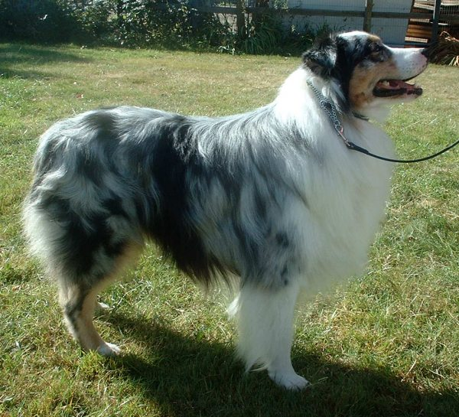
A dog.
1
Notes:
Indefinite article + noun
Dog = http://commons.wikimedia.org/wiki/File:Australian_Shepherd_600.jpg

Slide 3
A little dog
2
Notes:
Indefinite article + adjective + common noun
Dog = http://commons.wikimedia.org/wiki/File:Australian_Shepherd_600.jpg

Slide 4
One red dog.
3
Notes:
Adjective + common noun + common noun
Red dog = google images

Slide 5
One dog runs with me
4
Notes:
Adjective + common noun + present simple verb (3rd person singular) + preposition + pronoun
Running dog and person = http://commons.wikimedia.org/wiki/File:Running_woman_and_dog_during_marathon.JPG

Slide 6
It is my dog.
5
Notes:
Pronoun + present simple verb + determiner + common noun
Running dog and person = http://commons.wikimedia.org/wiki/File:Running_woman_and_dog_during_marathon.JPG

Slide 7
A mop.
6
Notes:
Indefinite article + common noun
Mop = http://upload.wikimedia.org/wikipedia/commons/f/f5/Mop.png

Slide 8
A little mop.
7
Notes:
Indefinite article + adjective + common noun
Mop = http://upload.wikimedia.org/wikipedia/commons/f/f5/Mop.png

Slide 9
My mop is little
8
Notes:
Determiner + common noun + present simple verb + adjective
Person image = http://commons.wikimedia.org/wiki/File:Running_woman_and_dog_during_marathon.JPG
Mop = http://upload.wikimedia.org/wikipedia/commons/f/f5/Mop.png

Slide 10
My mop is not big.
9
Notes:
Adjective + noun + verb (past simple irregular)
Person image = http://commons.wikimedia.org/wiki/File:Running_woman_and_dog_during_marathon.JPG
Mop = http://upload.wikimedia.org/wikipedia/commons/f/f5/Mop.png

Slide 11
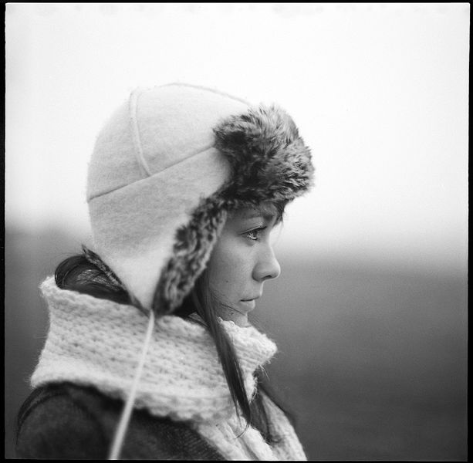
Look at my mop!
10
Notes:
Infinitive verb + preposition + determiner + common noun
Person looking = http://commons.wikimedia.org/wiki/File:Winter_Stare.jpg
Mop = http://upload.wikimedia.org/wikipedia/commons/f/f5/Mop.png

Slide 12
start again (if needed)
end show
slide 1

