Slide 1
Week 4 reading CVC and Dolch list words in sentences
Ideally, prior to showing these slides, print the slides and cut up the sentences and pictures. Ask the learners in groups to match them, then work through the slides and ask learners to correct as you go along.
The following sentences incorporate Dolch words and CVC words. Work slowly with the group, showing how to sound out the new CVC words and draw attention to the Dolch words than can’t be sounded out. Use comprehension questions as you present each slide and model new language.
Use the arrows on the keyboard to move forward or click the buttons. Press F5 on the keyboard to start the slideshow.
end show

Slide 2
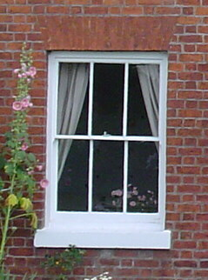
One window.
1
Notes:
Adjective + common noun
Window - http://commons.wikimedia.org/wiki/File:Window.jpg

Slide 3
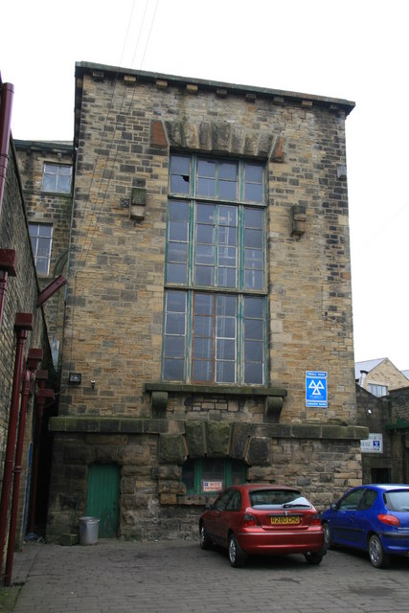
A big window.
2
Notes:
Indefinite article + adjective + noun
Big window = http://upload.wikimedia.org/wikipedia/commons/4/44/Waterloo_Mills%2C_Silsden_-_geograph.org.uk_-_409670.jpg

Slide 4
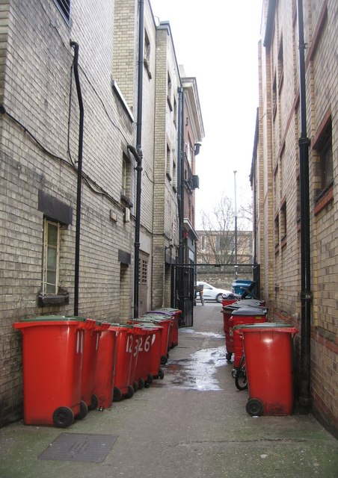
Find the window.
3
Notes:
Indefinite article + noun + noun
Blue window = http://commons.wikimedia.org/wiki/File:Blue-framed_window_-_geograph.org.uk_-_808696.jpg

Slide 5
A small window.
4
Notes:
indefinite article + adjective + common noun
Window - http://commons.wikimedia.org/wiki/File:Window.jpg

Slide 6
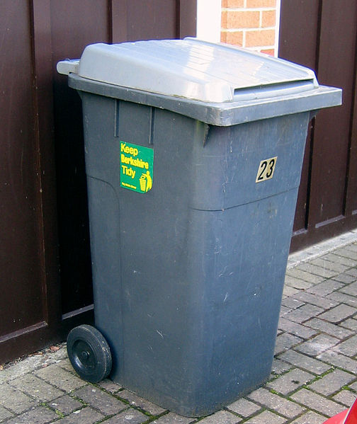
One bin.
5
1
Notes:
Adjective + noun
Bin = http://commons.wikimedia.org/wiki/File:Bin.JPG

Slide 7
A small bin.
6
Notes:
Indefinite article + adjective + common noun
Bin = http://commons.wikimedia.org/wiki/File:Bin.JPG

Slide 8
A blue bin.
7
Notes:
Indefinite article + noun + common noun
Blue bin =
http://commons.wikimedia.org/wiki/File:Blue_bin_day,_Omagh_-_geograph.org.uk_-_262964.jpg

Slide 9
A bin with a lid.
8
Notes:
Indefinite article + common noun + preposition + indefinite article + common noun
Bin = http://commons.wikimedia.org/wiki/File:Bin.JPG

Slide 10
Find the blue bin.
9
Notes:
Infinitive verb + definite article + adjective + noun
Blue bin - http://commons.wikimedia.org/wiki/File:Blue_bin_day,_Omagh_-_geograph.org.uk_-_262964.jpg
Grey bin = http://commons.wikimedia.org/wiki/File:Bin.JPG
Red bins = http://upload.wikimedia.org/wikipedia/commons/9/9b/Red_Refuse_Bins_-_geograph.org.uk_-_1111502.jpg

Slide 11
start again (if needed)
end show
slide 1

