Slide 1
Week 4 reading CVC and Dolch list words in sentences
Ideally, prior to showing these slides, print the slides and cut up the sentences and pictures. Ask the learners in groups to match them, then work through the slides and ask learners to correct as you go along.
The following sentences incorporate Dolch words and CVC words. Work slowly with the group, showing how to sound out the new CVC words and draw attention to the Dolch words than can’t be sounded out. Use comprehension questions as you present each slide and model new language.
Use the arrows on the keyboard to move forward or click the buttons. Press F5 on the keyboard to start the slideshow.
end show

Slide 2
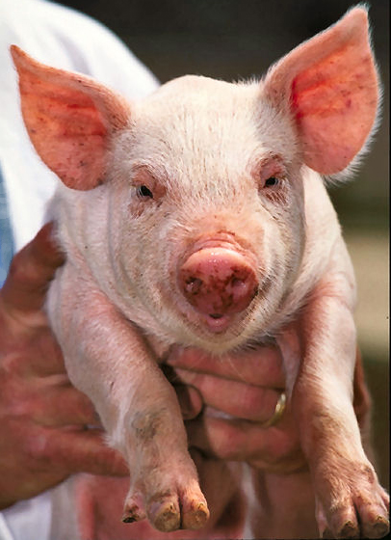
A pig.
1
Notes:
Indefinite article + noun
Pig = http://commons.wikimedia.org/wiki/File:Pig_USDA01c0116.jpg

Slide 3
Help the pig!
2
Notes:
Verb + definite article + noun + exclamation mark
Pig = http://commons.wikimedia.org/wiki/File:Pig_USDA01c0116.jpg

Slide 4
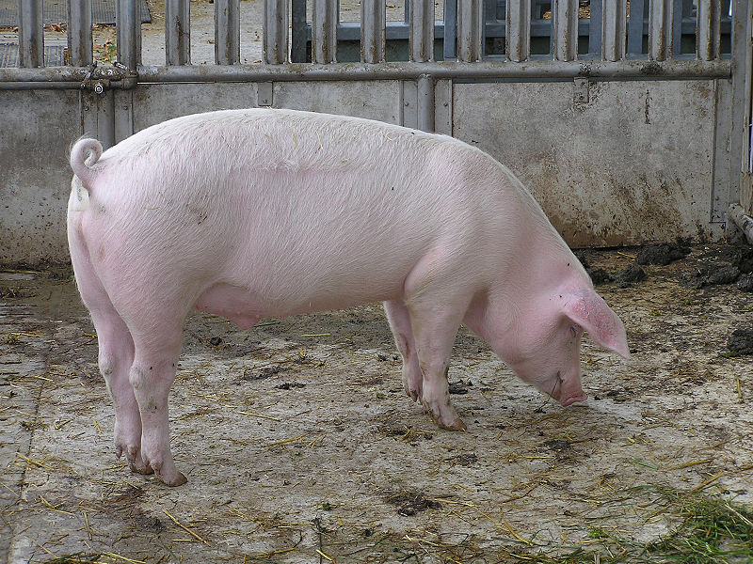
A big pig.
3
Notes:
Indefinite article + adjective + noun
Big pig = http://commons.wikimedia.org/wiki/File:Sus_scrofa_scrofa.jpg

Slide 5
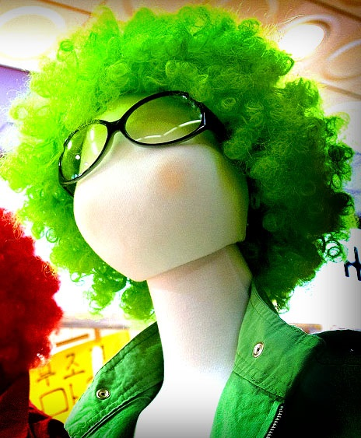
A wig.
4
Notes:
Indefinite article + common noun
Wig = http://commons.wikimedia.org/wiki/File:Colourful_wigs.jpg

Slide 6
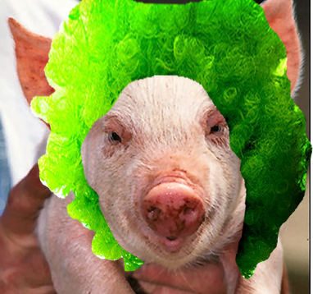
A pig in a wig.
5
Notes:
Indefinite article + common noun + preposition + indefinite article + common noun
Google image

Slide 7
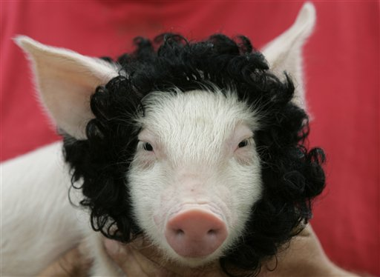
A funny pig.
6
Notes:
Indefinite article + adjective + common noun
Google image

Slide 8
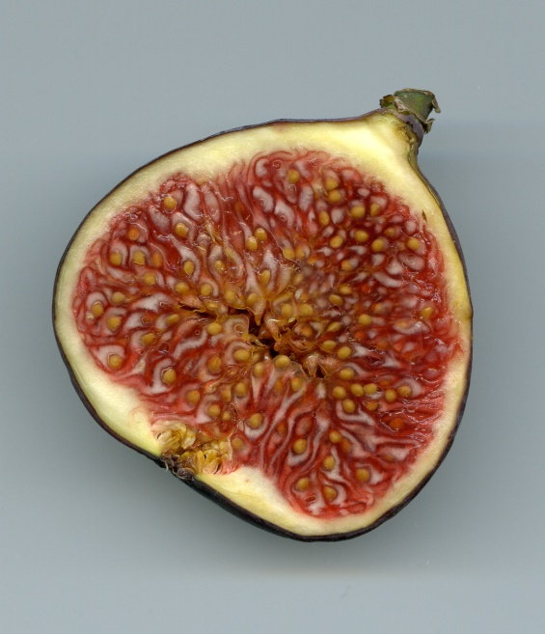
A pig and a fig.
7
Notes:
Indefinite article + common noun + conjunction + indefinite article + common noun
Pig = http://commons.wikimedia.org/wiki/File:Pig_USDA01c0116.jpg
Fig = http://commons.wikimedia.org/wiki/File:Feige-Schnitt.jpg

Slide 9
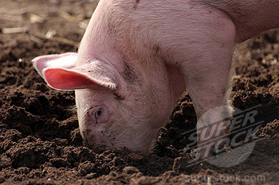
One pig digs.
8
Notes:
Adjective + noun + verb (third person singular present simple)
Google image

Slide 10
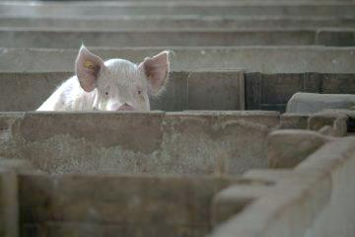
One pig hid.
9
Notes:
Adjective + noun + verb (past simple irregular)
Google images

Slide 11
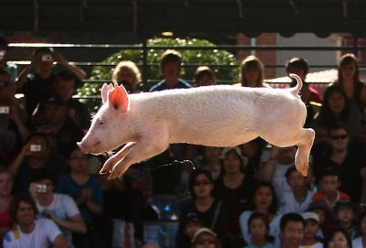
One pig jumps.
10
Notes:
Adjective + common noun + verb (third person singular present simple)
Google images

Slide 12
start again (if needed)
end show
slide 1

