Slide 1
Week 3 reading CVC and Dolch list words in sentences
Ideally, prior to showing these slides, print the slides and cut up the sentences and pictures. Ask the learners in groups to match them, then work through the slides and ask learners to correct as you go along.
The following sentences incorporate Dolch words and CVC words. Work slowly with the group, showing how to sound out the new CVC words and draw attention to the Dolch words than can’t be sounded out. Use comprehension questions as you present each slide and model new language.
Use the arrows on the keyboard to move forward or click the buttons. Press F5 on the keyboard to start the slideshow.
end show

Slide 2
Ned is a man.
1
Notes:
Proper noun + verb + indefinite article + common noun
Is = Third person singular present indicative of be.
Are = Second person singular and plural and first and third person plural, present indicative of be
Present indicative = Present tense in the indicative mood
Indicative mood = the mood of a verb used in ordinary, factual or objective statements

Slide 3
One man.
2
1
Notes:
Adjective + noun

Slide 4
A bed.
3
Notes:
indefinite article + common noun

Slide 5
A big bed.
4
Notes:
indefinite article + adjective + common noun

Slide 6
One bed.
5
1

Slide 7
A bed for Ned.
6

Slide 8
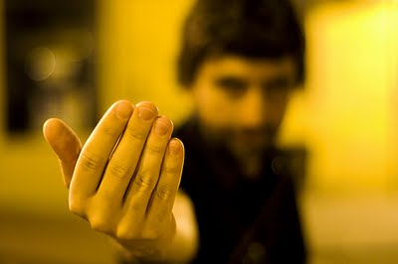
Come here Ned.
7
Notes:
intransitive verb + adverb + noun
come = to move toward something
intransitive verb = not having or containing a direct object / noun

Slide 9
Go away Ned.
8
Notes:
irregular verb + adverb + noun
go away = (intransitive adverb) to leave, as when starting from home on holiday
intransitive verb = not having or containing a direct object / noun
away = from a particular thing or place: ran away from the lion; sent the children away to boarding school.

Slide 10
Go to bed Ned.
9
Notes:
irregular verb + preposition + noun + noun

Slide 11
start again (if needed)
end show
slide 1

