Slide 1
Week 3 reading CVC and Dolch list words in sentences
Ideally, prior to showing these slides, print the slides and cut up the sentences and pictures. Ask the learners in groups to match them, then work through the slides and ask learners to correct as you go along.
The following sentences incorporate Dolch words and CVC words. Work slowly with the group, showing how to sound out the new CVC words and draw attention to the Dolch words than can’t be sounded out. Use comprehension questions as you present each slide and model new language.
Use the arrows on the keyboard to move forward or click the buttons. Press F5 on the keyboard to start the slideshow.
end show

Slide 2
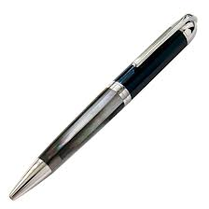
A pen.
1
Notes:
Indefinite article + noun

Slide 3
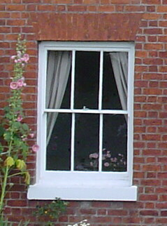
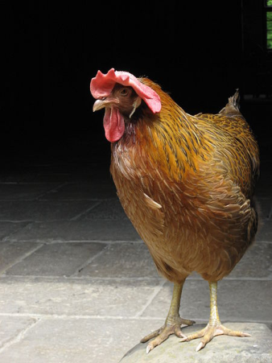
Find the pen.
2
Notes:
Verb + definite article + noun

Slide 4
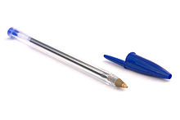
A blue pen.
3
Notes:
Indefinite article + adjective + noun

Slide 5
A pen for Ted.
4
Notes:
Indefinite article + noun + preposition + noun
FOR, preposition – here used to mean
intended to belong to or be used in connection with: equipment for the army; a closet for dishes.
Ted = http://commons.wikimedia.org/wiki/File:Jens_Fink-Jensen.jpg

Slide 6
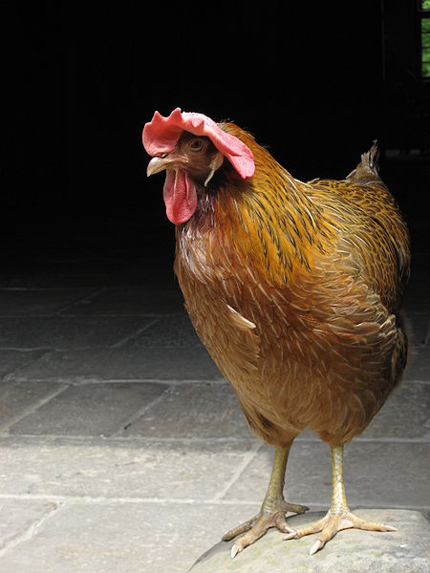
A hen.
5
Notes:
Indefinite article + noun
Hen = http://commons.wikimedia.org/wiki/File:Hen_V.jpg

Slide 7
Find the hen.
6
Notes:
Verb + definite article + noun

Slide 8
A small hen.
7
Notes:
Indefinite article + adjective + noun

Slide 9
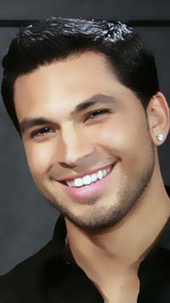
Ben fed the hen.
8
Notes:
Proper noun + verb (irregular past tense / past participle of feed) + definite article + common noun
past participle
A verb form indicating past or completed action or time that is used as a verbal adjective in phrases such as baked beans and finished work and with auxiliaries to form the passive voice or perfect and tenses in constructions such as She had baked the beans and The work was finished. Also called perfect participle.
Ben = http://commons.wikimedia.org/wiki/File:Covino_bio.jpg
Hand = http://commons.wikimedia.org/wiki/File:Alisterus_scapularis_-hand_feeding-8.jpg

Slide 10
Ted and Ben are men.
9
Notes:
Noun + conjunction + noun + verb + plural noun
Are .verb
Second person singular and plural and first and third person plural, present indicative of be
Present indicative = Present tense in the indicative mood
Indicative mood = the mood of a verb used in ordinary, factual or objective statements

Slide 11
Two men.
10
2
Notes:
Adjective + plural noun

Slide 12
start again (if needed)
end show
slide 1

