Slide 1
Week 21 The town centre
end show
Notes:
Adapted from Nighat Butt

Slide 2
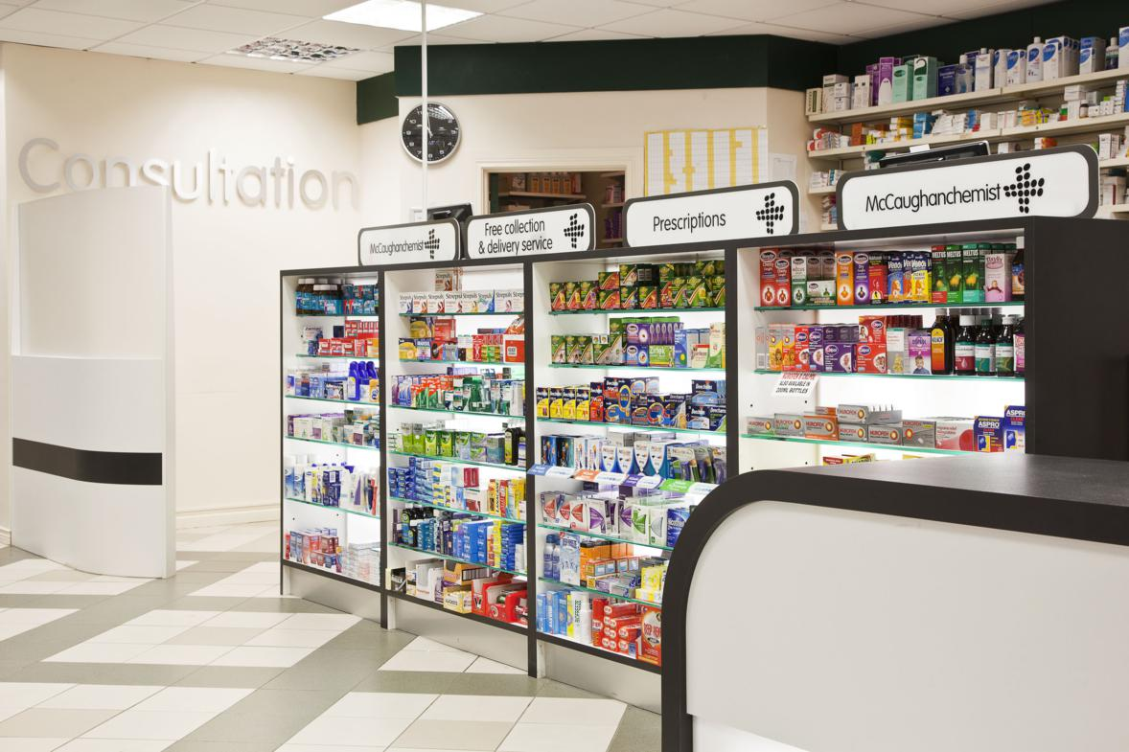
chemist

Slide 3
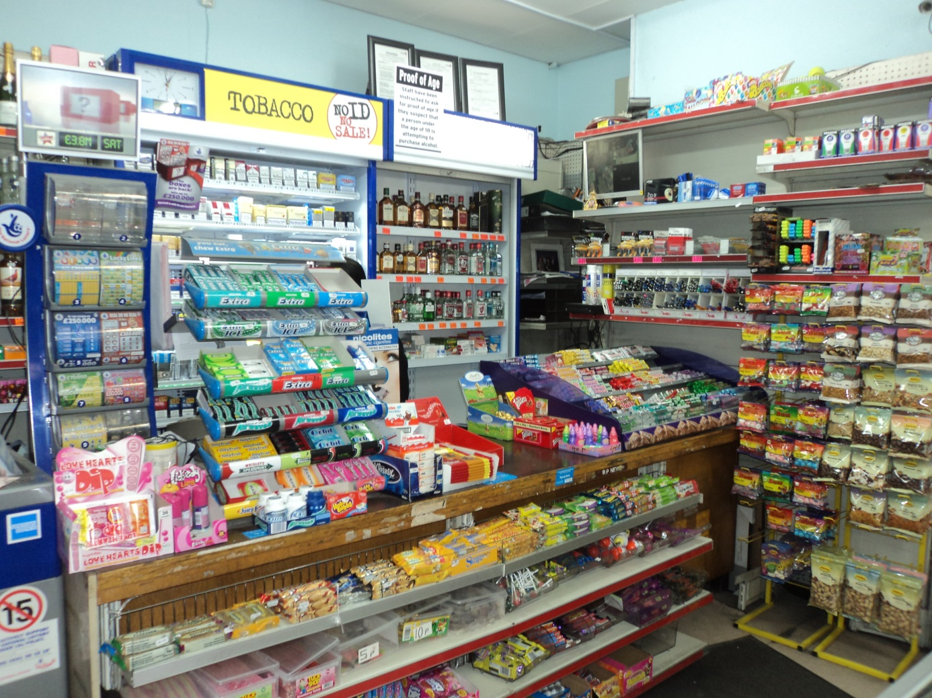
Newsagent

Slide 4
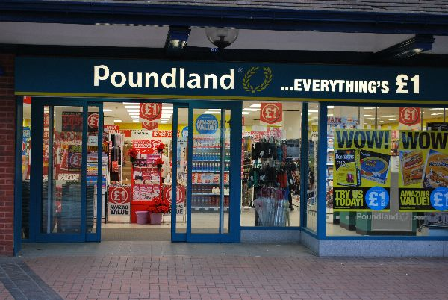
Discount store

Slide 5
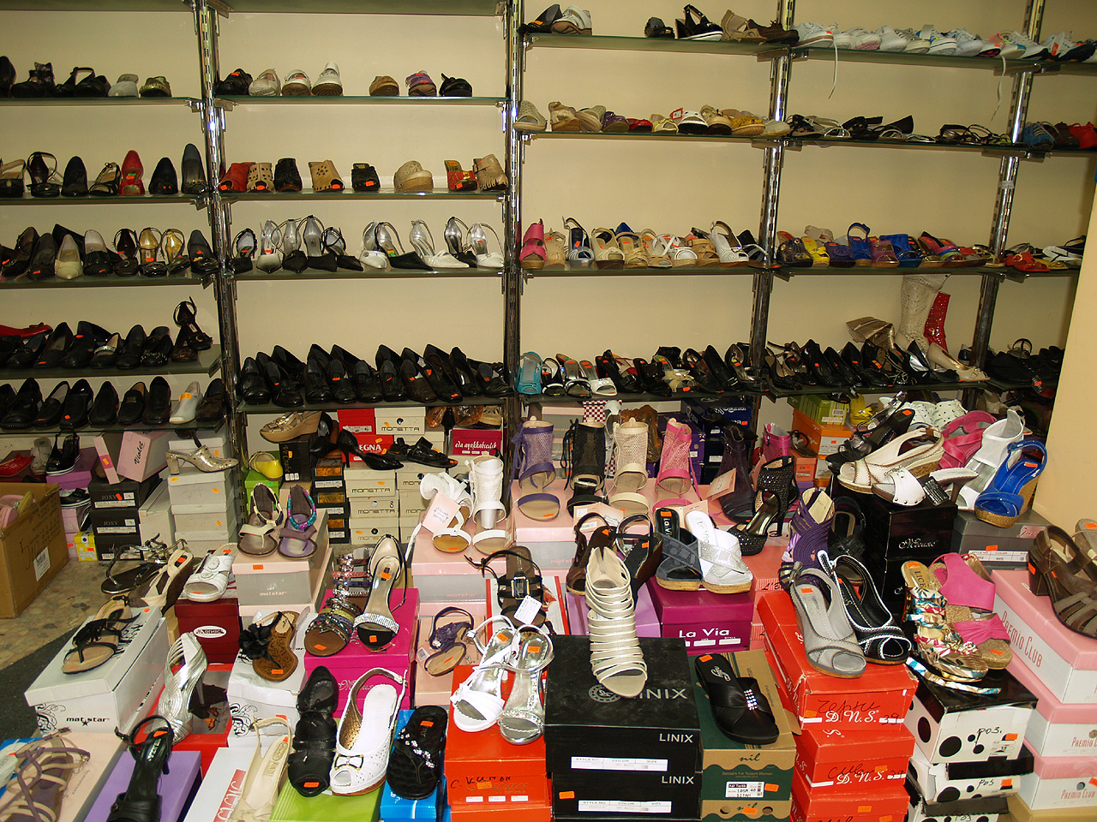
Shoe shop

Slide 6
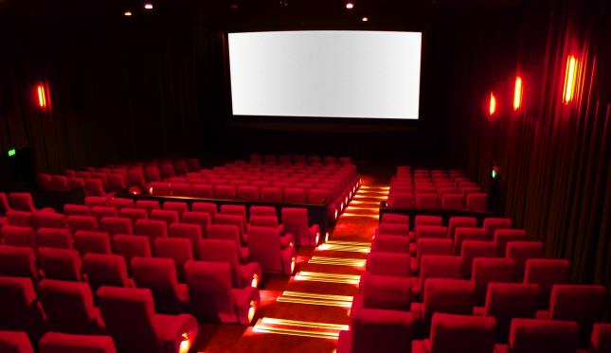
Cinema

Slide 7
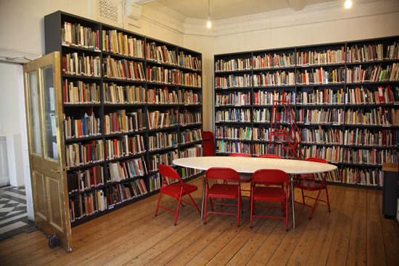
Library

Slide 8
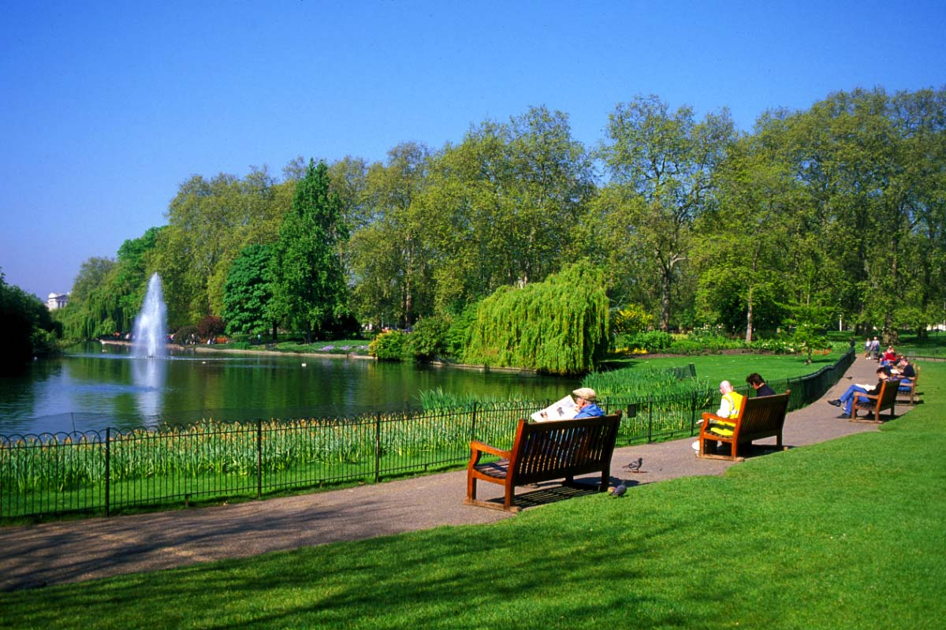
Park

Slide 9
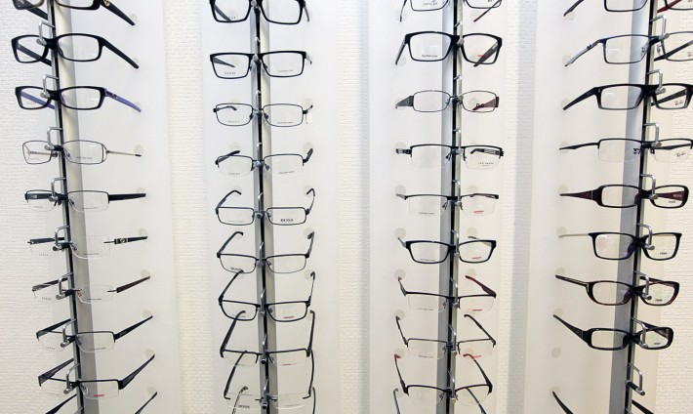
Opticians

