Slide 1
Week 2 – words 2 Can you help me?
Present one slide at a time, reading for the learners and getting them to mimic. Spell out CVC words using phonics, such as ‘hello’ ‘is’ and standard letter sounds for Dolch words. Use this activity as a diagnostic, reading one letter at a time, asking them to repeat and say and write the letters on A4 paper, and to show you, then moving onto the words and pronunciation. Drill the words. Later building the words into sentences. After a length of drilling, hand out the worksheets and ask them to complete the first column, writing down each word as you say it.
Use the arrows on the keyboard to move forward or click the buttons. Press F5 on the keyboard to start the slideshow.
end show

Slide 2
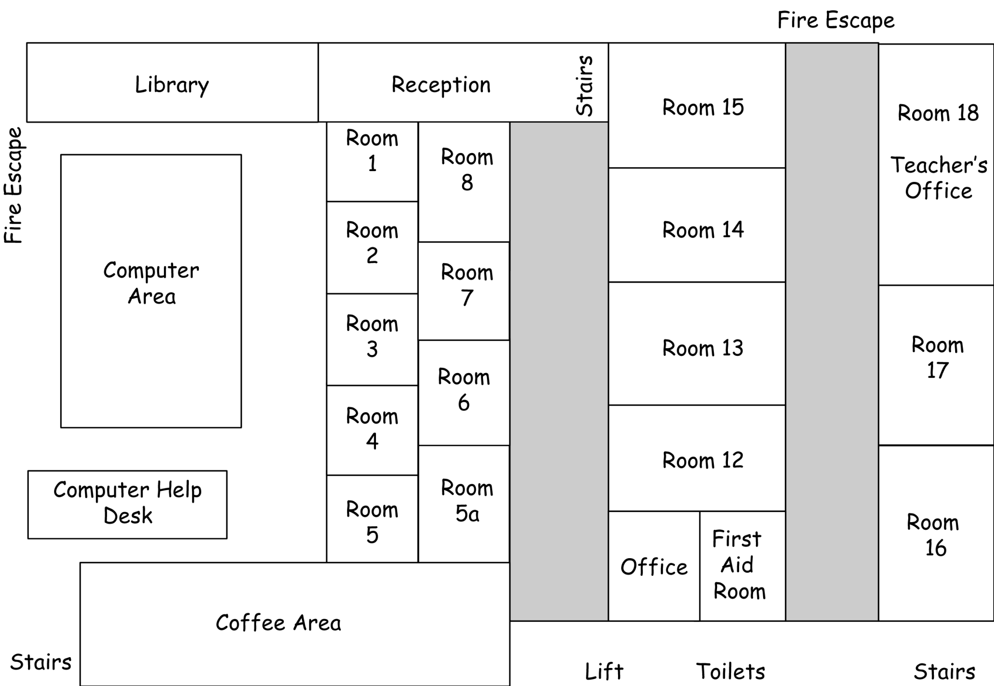

Slide 3
can
10
8
6
5
4
3
1
2
7
9

Slide 4
you
10
8
6
5
4
3
1
2
7
9

Slide 5
help
10
8
6
5
4
3
1
2
7
9

Slide 6
me
10
8
6
5
4
3
1
2
7
9

Slide 7
how
10
8
6
5
4
3
1
2
7
9

Slide 8
where
10
8
6
5
4
3
1
2
7
9

Slide 9
room
10
8
6
5
4
3
1
2
7
9

Slide 10
the
10
8
6
5
4
3
1
2
7
9

Slide 11
here
10
8
6
5
4
3
1
2
7
9

Slide 12
there
10
8
6
5
4
3
1
2
7
9

Slide 13
Can you help me?
How can I help you?

Slide 14
Where is the office?
The office is there.

Slide 15
Can you help me?
How can I help you?

Slide 16
Where is the …
The ______ is / are here / there.

Slide 17
start again (but faster)
end show
slide 1

