Slide 1
Week 2 College areas (Enfield)
Present one slide at a time, reading for the learners and getting them to mimic. Spell out CVC words using phonics and standard letter sounds for Dolch words. Use this activity as a diagnostic, reading one letter at a time, asking them to repeat and say and write the letters on A4 paper, and to show you, then moving onto the words and pronunciation. After a length of drilling, hand out the worksheets and ask them to complete the first column, writing down each word as you say it.
Use the arrows on the keyboard to move forward or click the buttons. Press F5 on the keyboard to start the slideshow.
end show

Slide 2
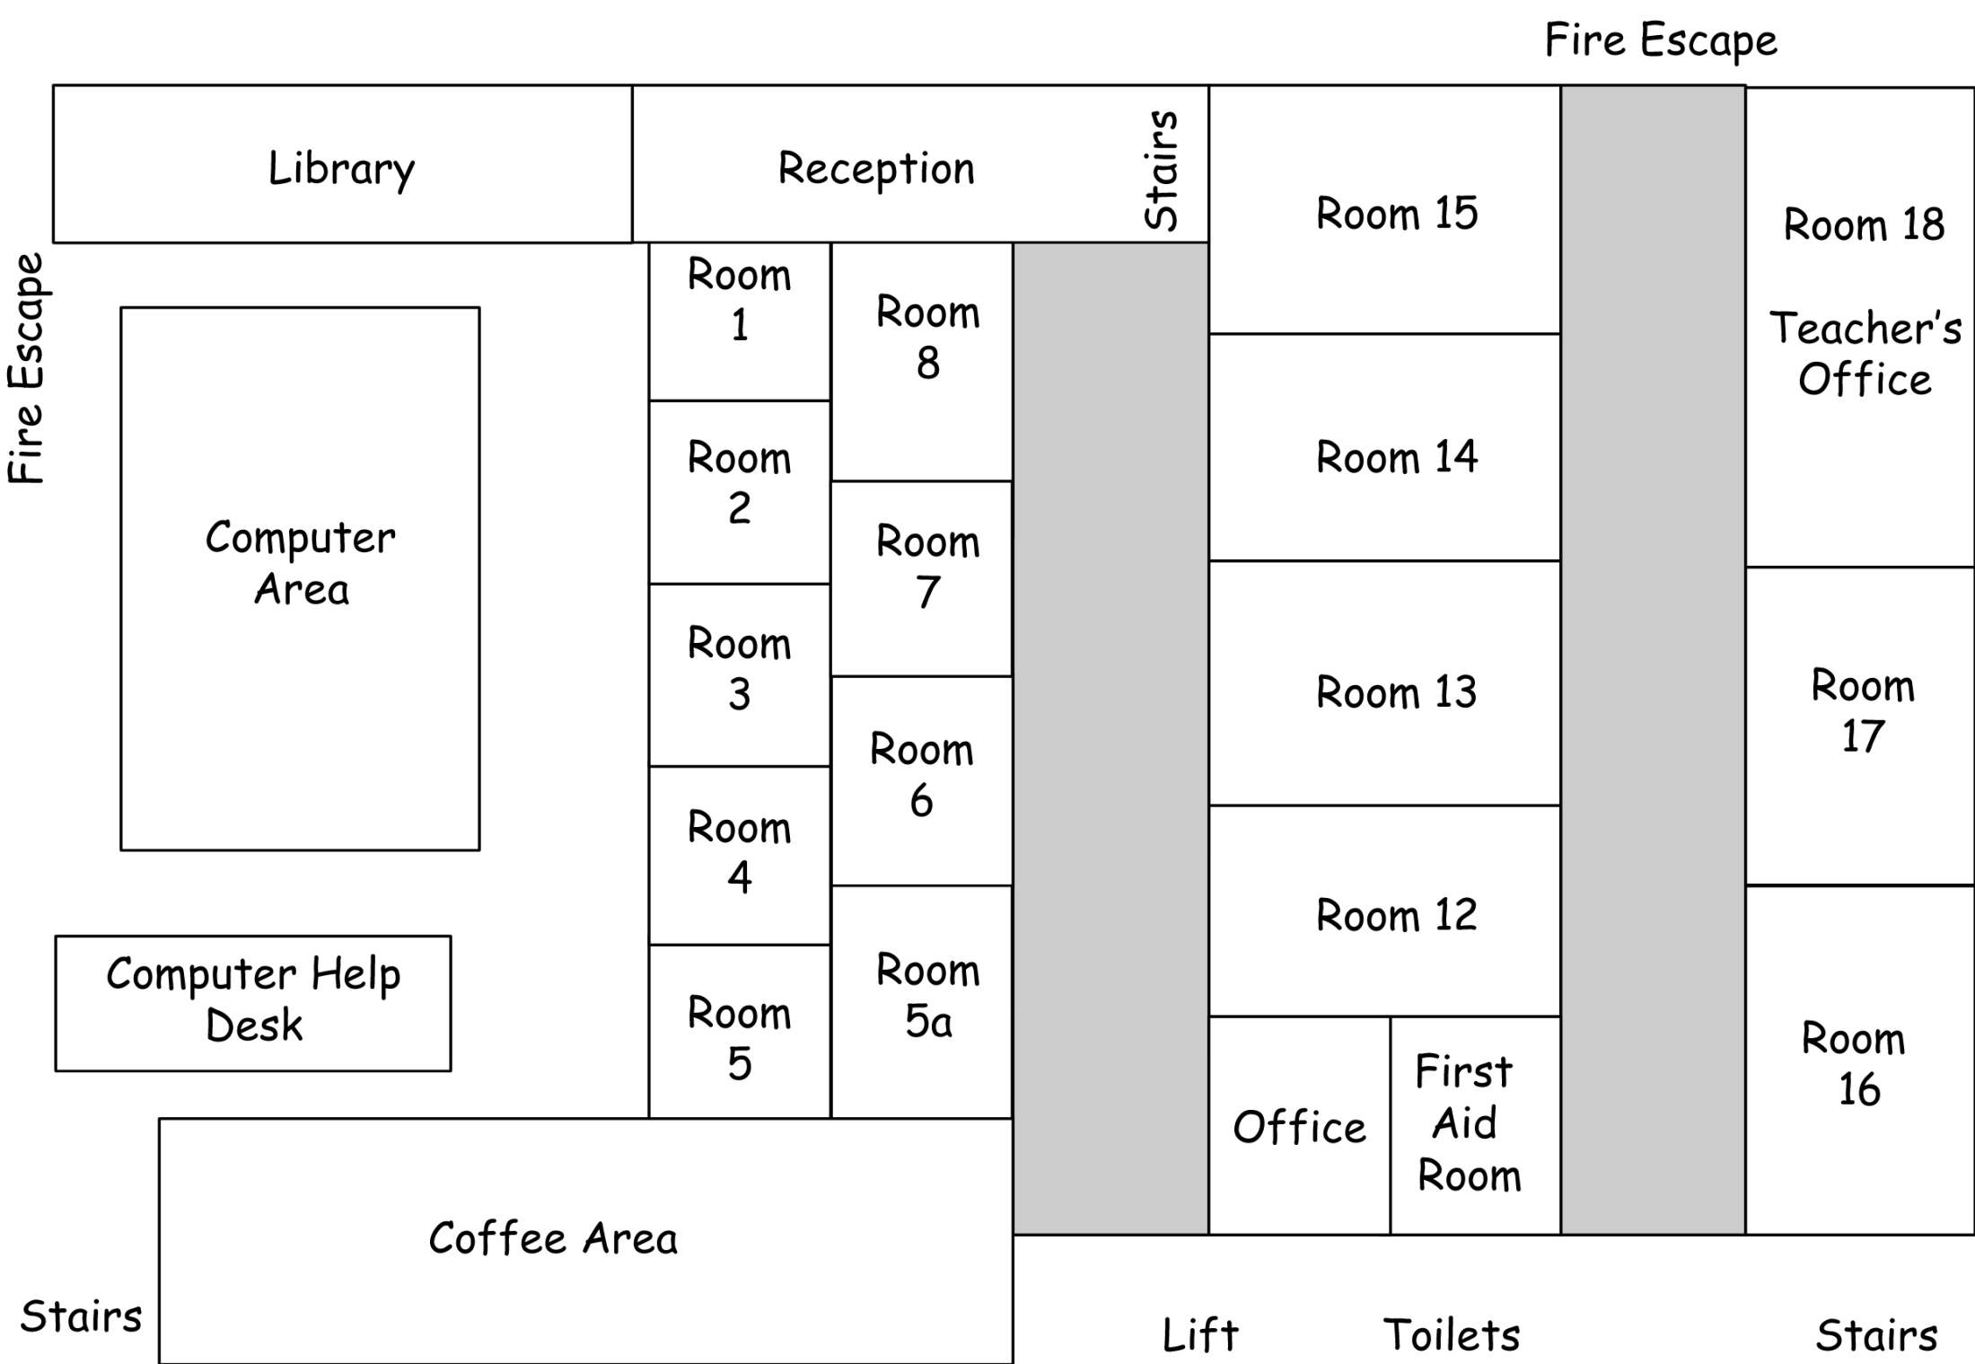

Slide 3
reception
10
8
6
5
4
3
1
2
7
9

Slide 4
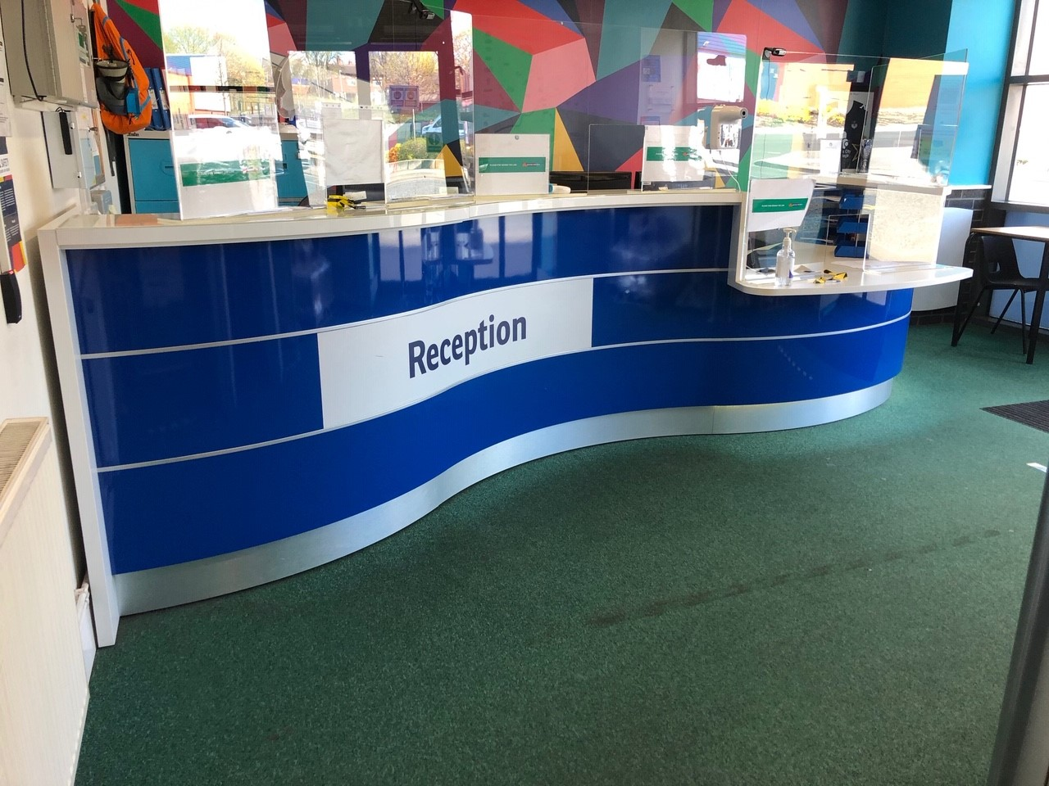
reception

Slide 5
stairs
10
8
6
5
4
3
1
2
7
9

Slide 6
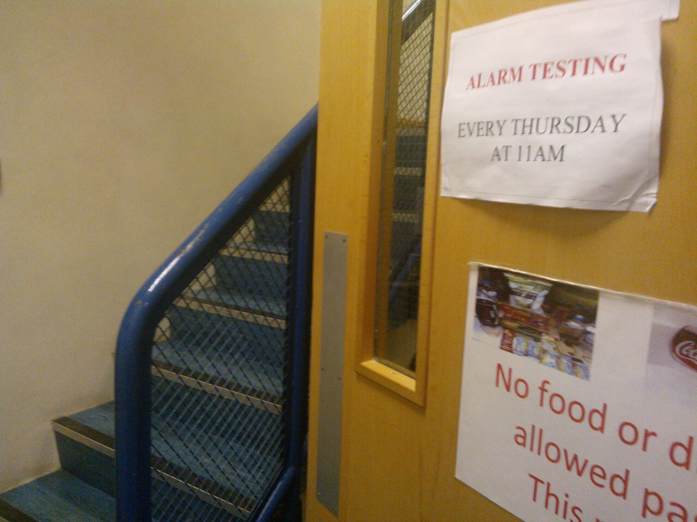
stairs

Slide 7
toilets
10
8
6
5
4
3
1
2
7
9

Slide 8
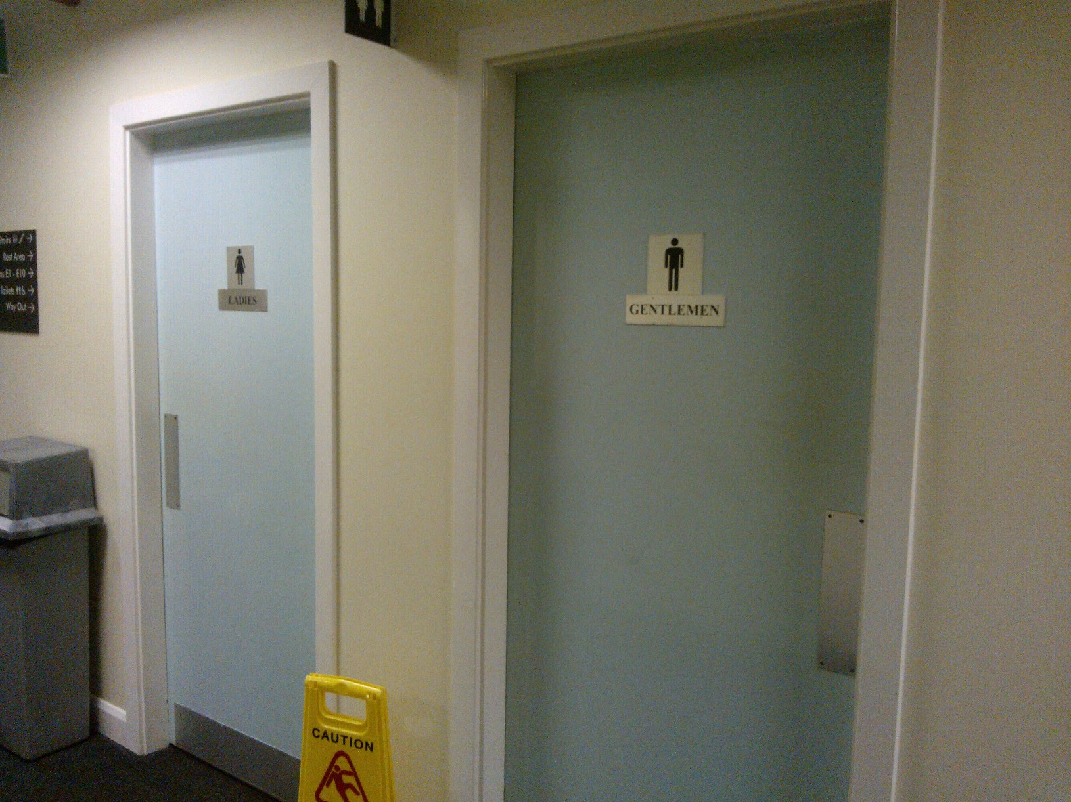
toilets

Slide 9
lift
10
8
6
5
4
3
1
2
7
9

Slide 10
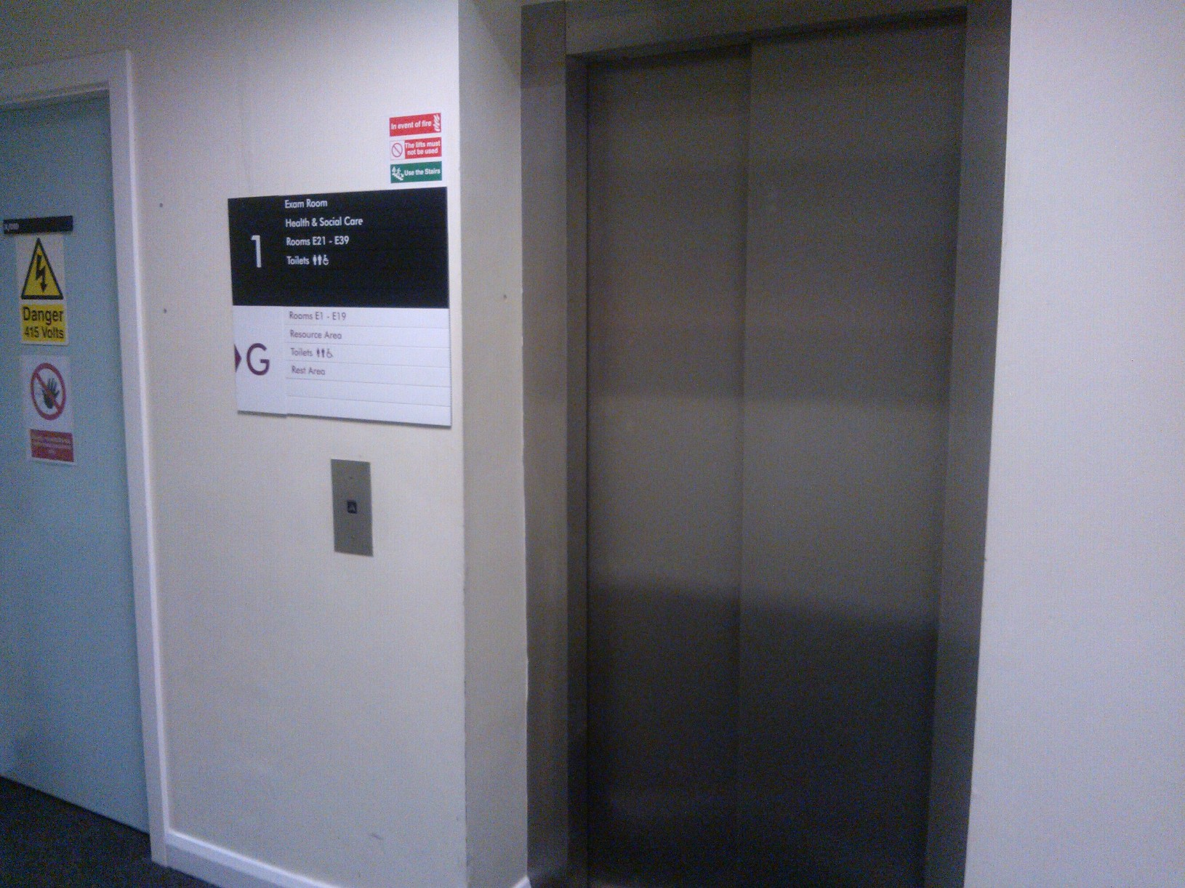
lift

Slide 11
office
10
8
6
5
4
3
1
2
7
9

Slide 12
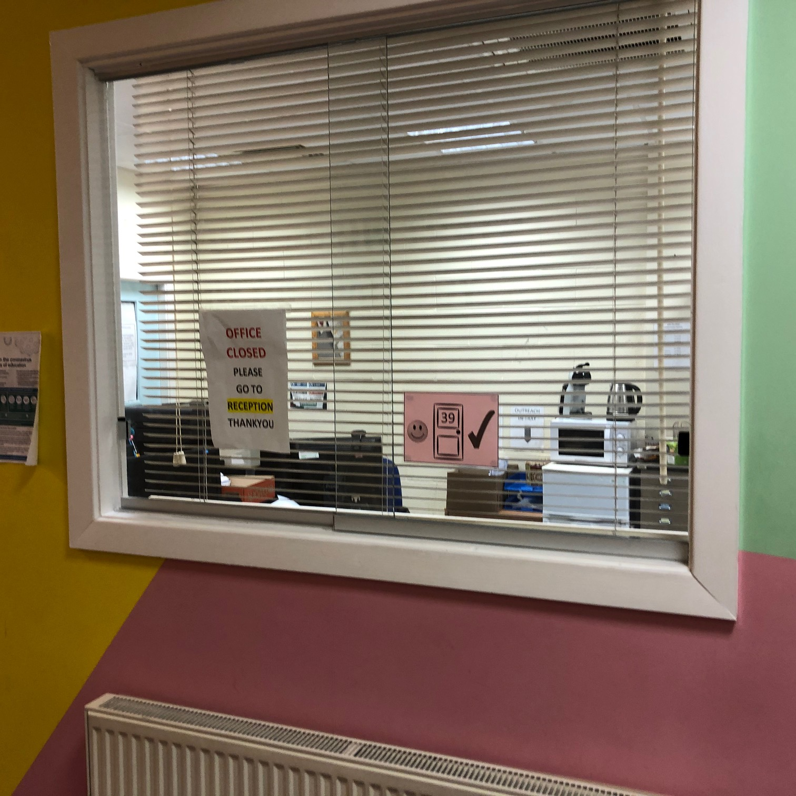
office

Slide 13
coffee area
10
8
6
5
4
3
1
2
7
9

Slide 14
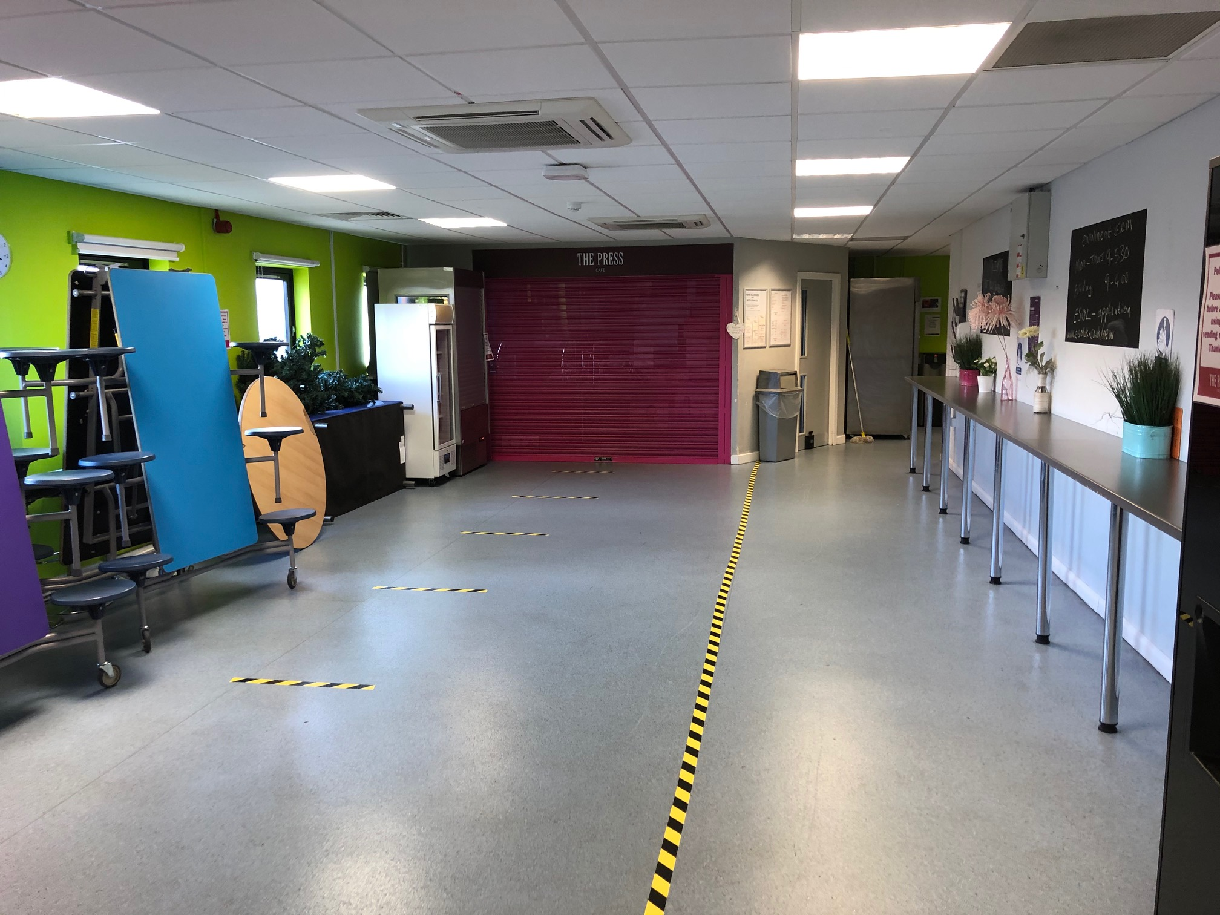
coffee area
cafe

Slide 15
computer area
10
8
6
5
4
3
1
2
7
9

Slide 16
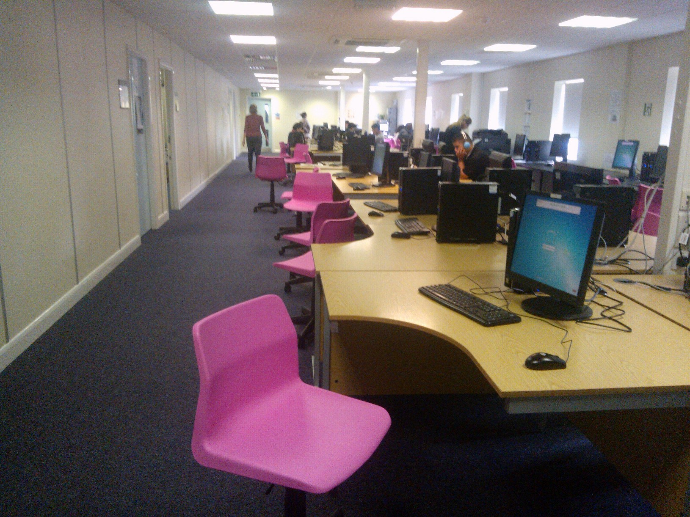
computer area

Slide 17
library
10
8
6
5
4
3
1
2
7
9

Slide 18
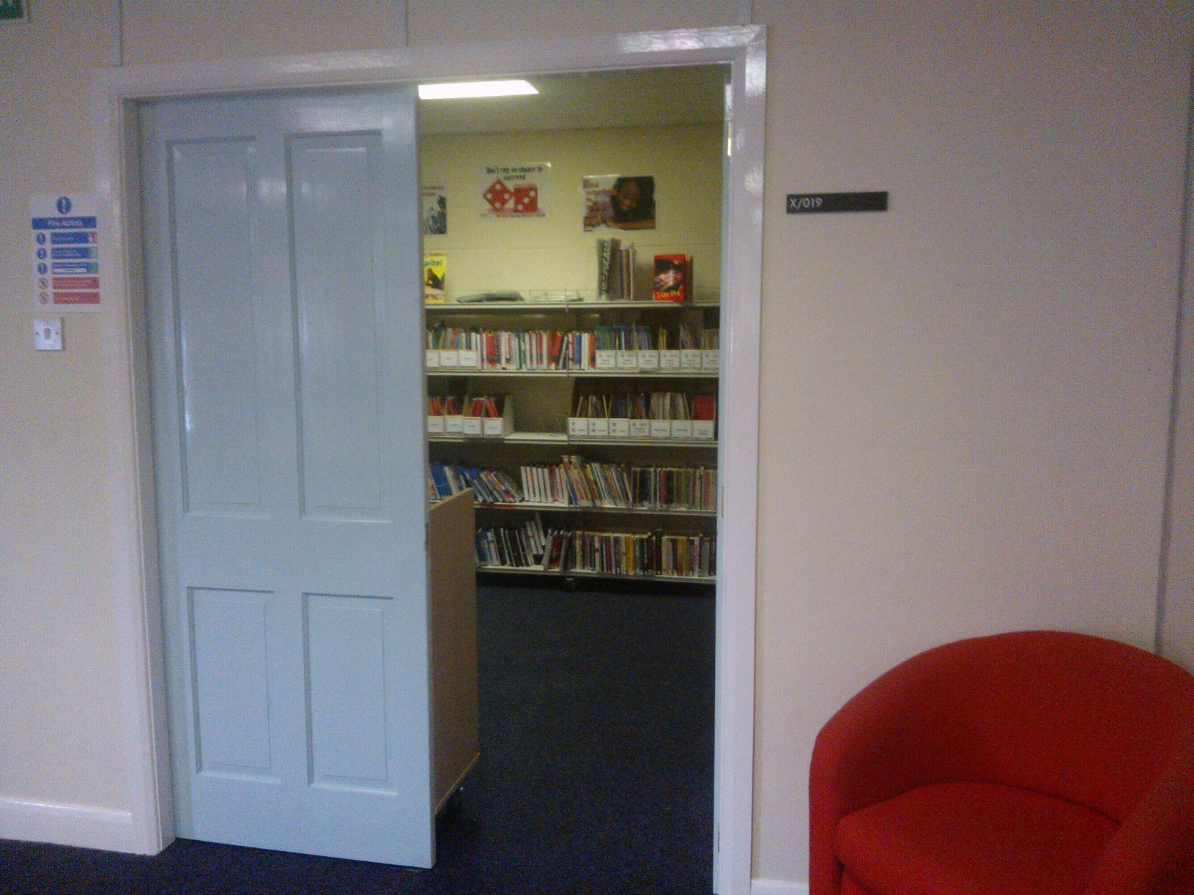
library

Slide 19
here
10
8
6
5
4
3
1
2
7
9

Slide 20
there
10
8
6
5
4
3
1
2
7
9

Slide 21
start again (but faster)
end show
slide 1

