Slide 1
Week 2 - Sentences 1 Places / areas
Open this document to cut out words to sequence on pages 2 to 5.
Provide the worksheets. Display the blank dialogue on slides 2 and 3. Provide cut outs of the words and ask students to sequence the words correctly in each speech bubble.
Use the arrows on the keyboard to move forward or click the buttons. Press F5 on the keyboard to start the slideshow.
end show

Slide 2
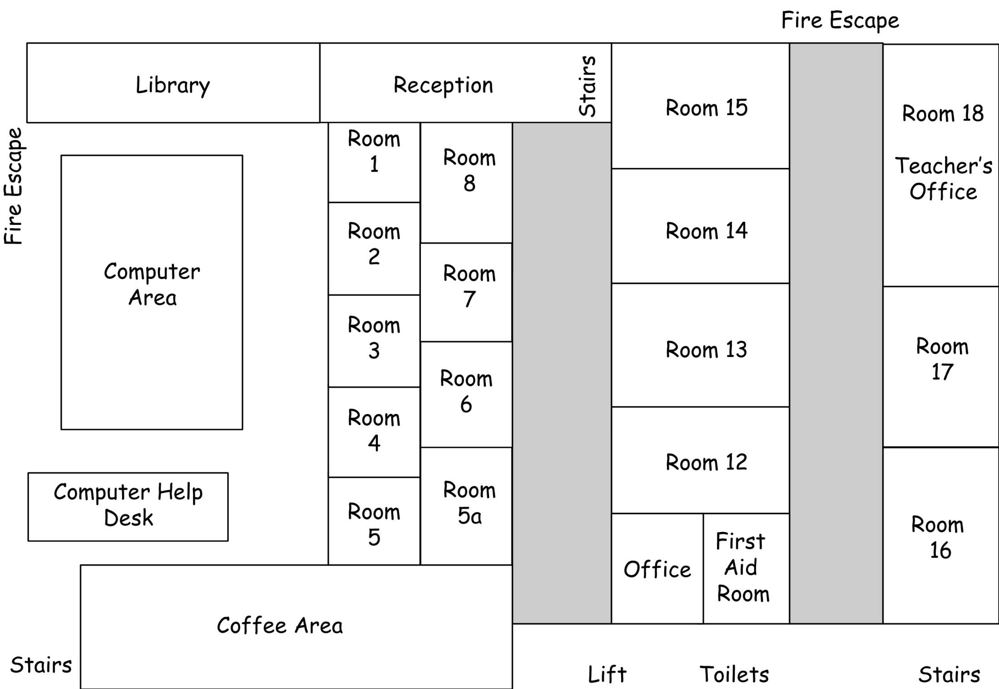

Slide 3
reception
10
8
6
5
4
3
1
2
7
9

Slide 4
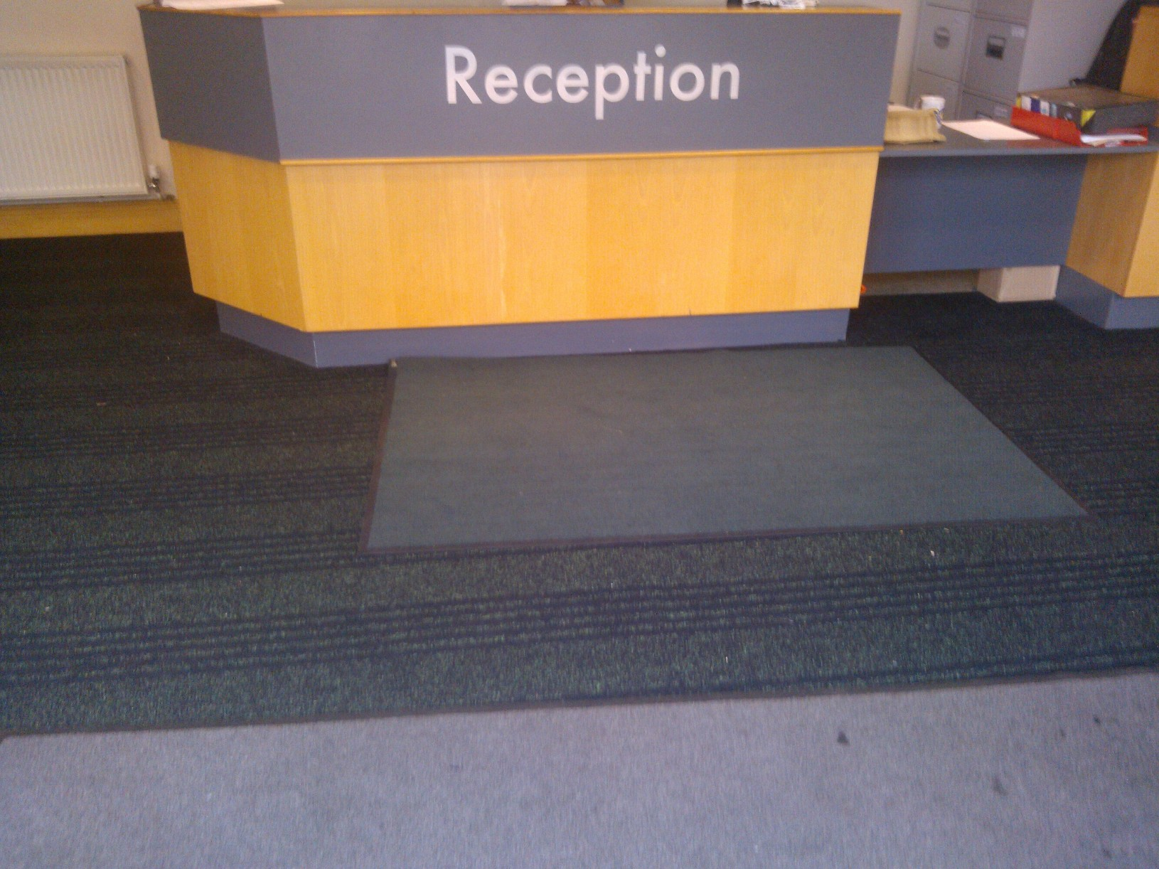
The reception is here.

Slide 5
stairs
10
8
6
5
4
3
1
2
7
9

Slide 6
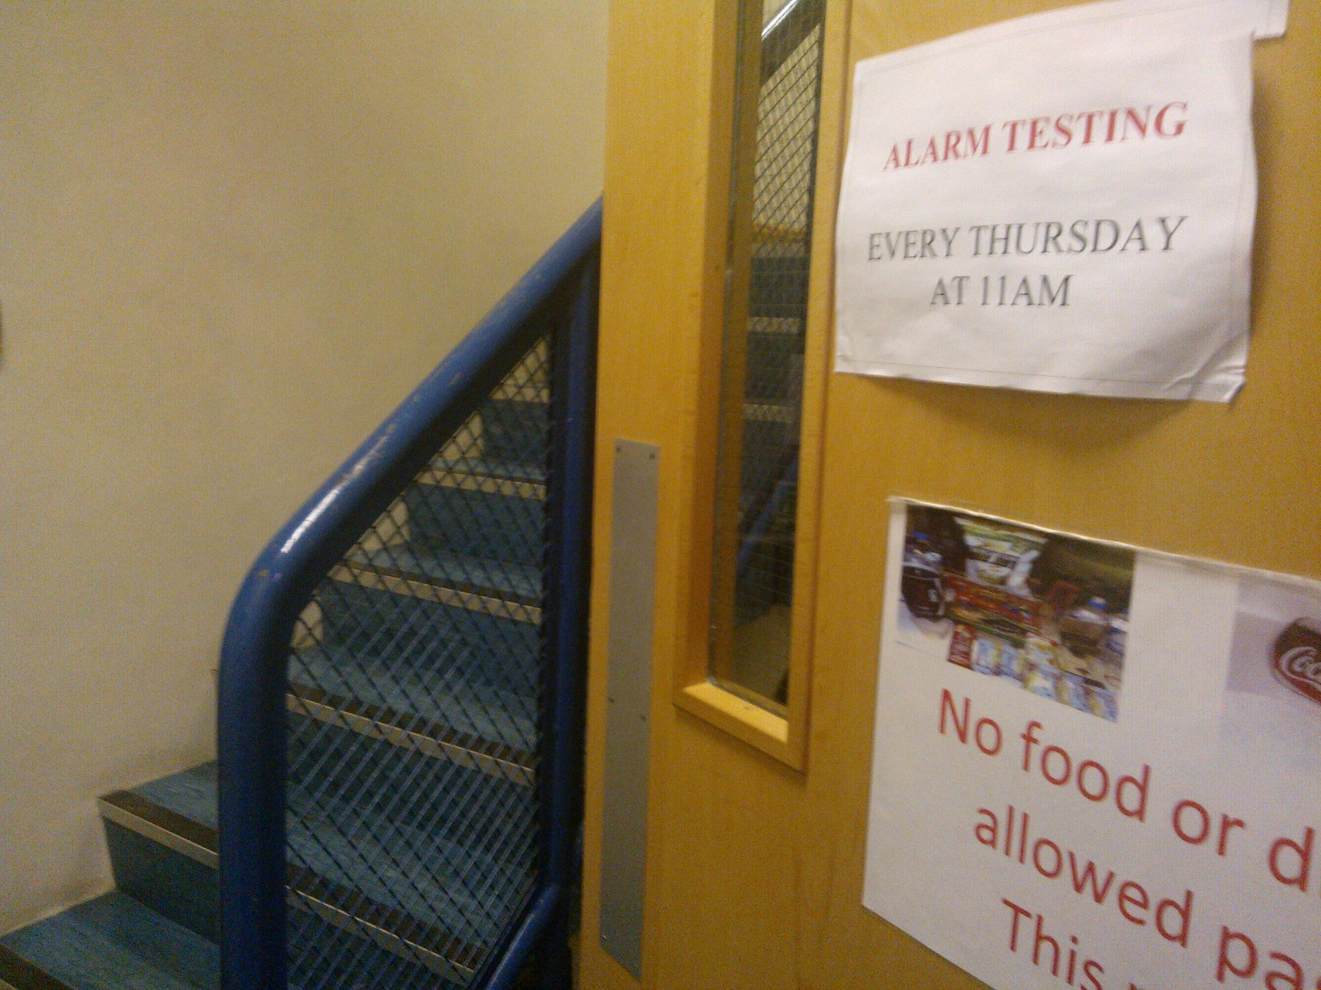
The stairs are here.

Slide 7
toilets
10
8
6
5
4
3
1
2
7
9

Slide 8
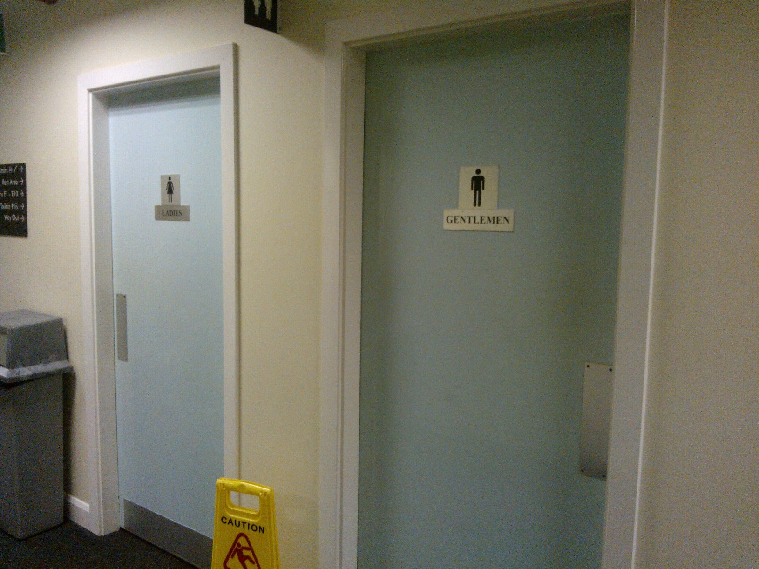
The toilets are there.

Slide 9
lift
10
8
6
5
4
3
1
2
7
9

Slide 10
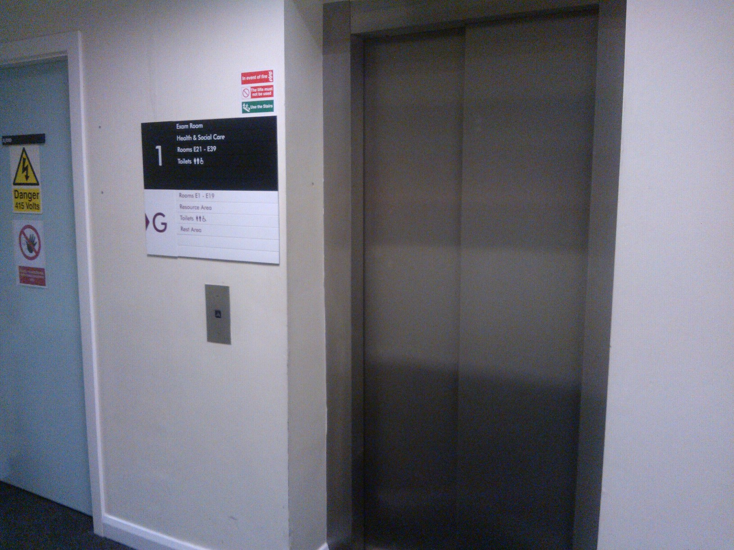
The lift is here.

Slide 11
office
10
8
6
5
4
3
1
2
7
9

Slide 12
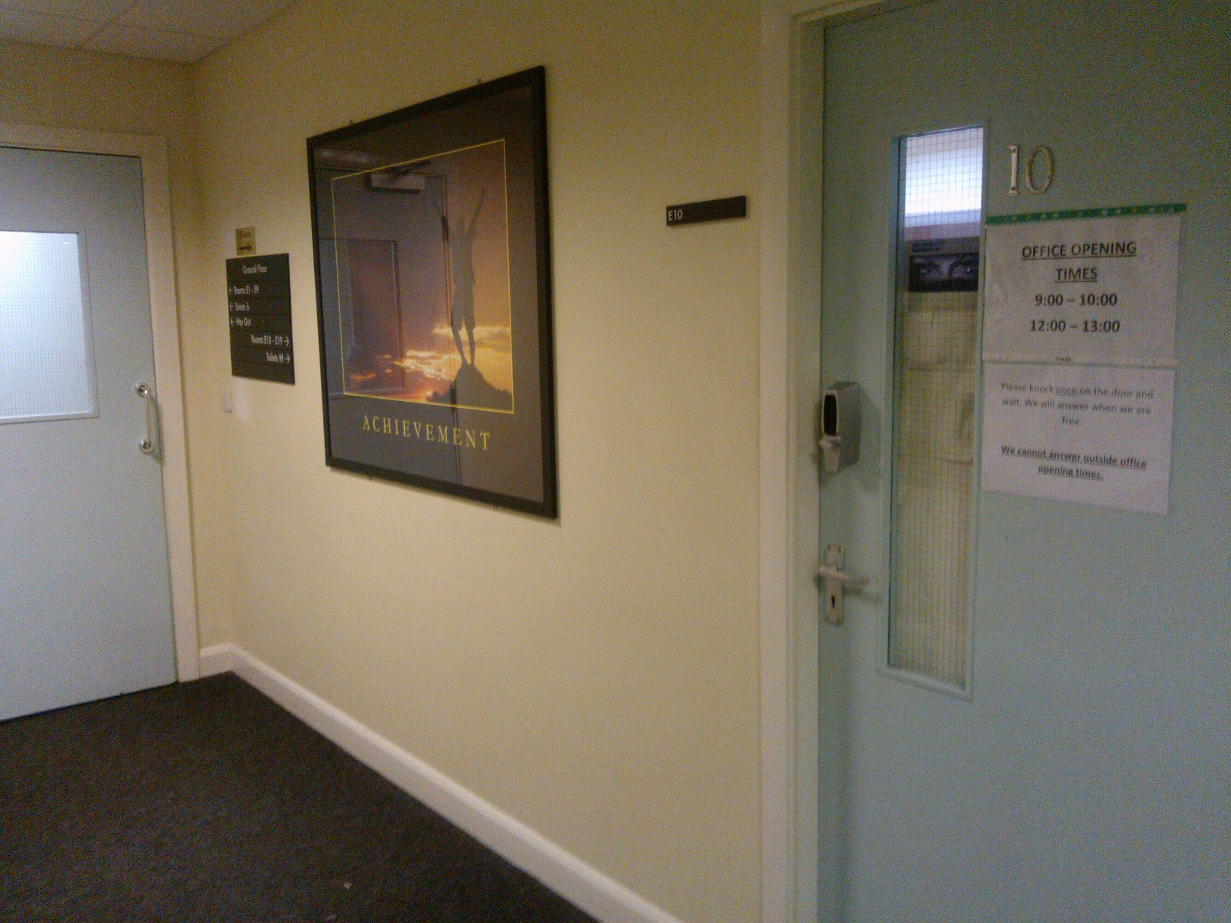
The office is here.

Slide 13
coffee area
10
8
6
5
4
3
1
2
7
9

Slide 14
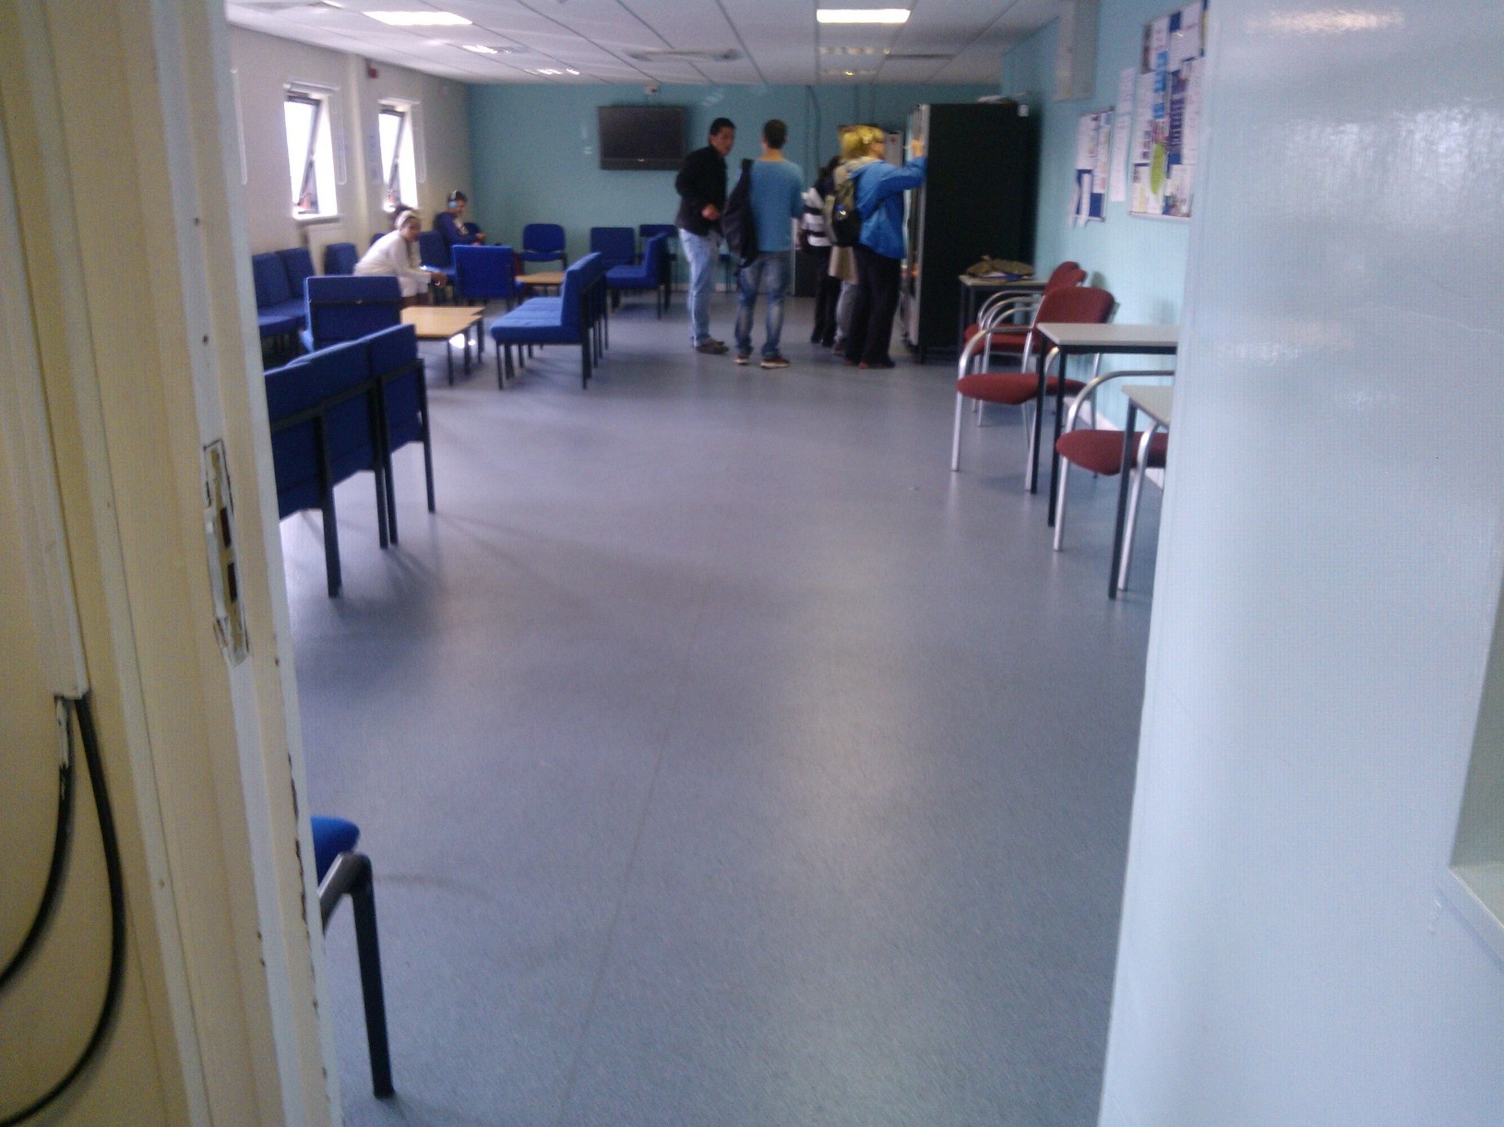
The coffee area is there.

Slide 15
library
10
8
6
5
4
3
1
2
7
9

Slide 16
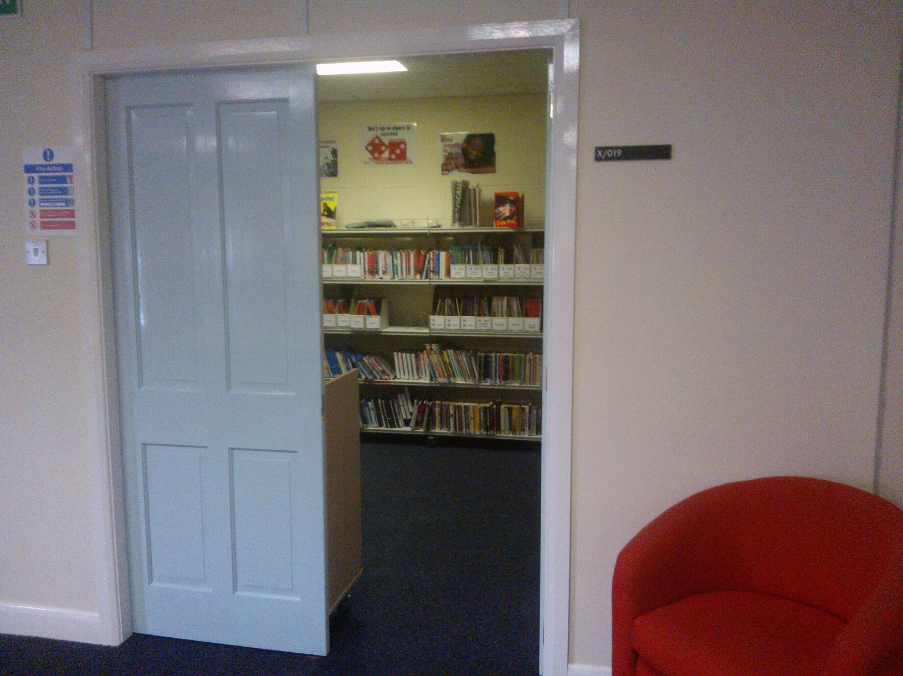
The library is there.

Slide 17
start again (but faster)
end show
slide 1

