Slide 1
Week 19
Ideally, prior to showing these slides, print the slides and cut up the sentences and pictures. Ask the learners in groups to match them, then work through the slides and ask learners to correct as you go along.
Use the arrows on the keyboard to move forward or click the buttons. Press F5 on the keyboard to start the slideshow.
end show
Notes:
Prepositions of time and present simple tense
Prepositions of place

Slide 2
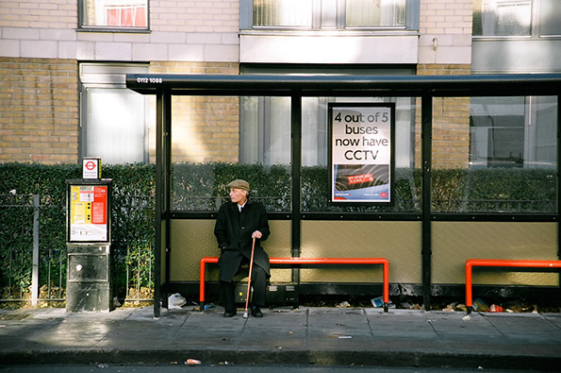
1
Bob is waiting for a bus.

Slide 3
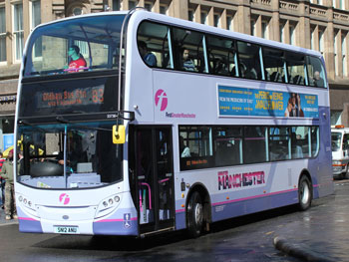
The bus is late.
?

Slide 4
He is still waiting.

Slide 5
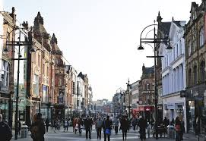
He wants to go to town.

Slide 6
The bus is arriving.

Slide 7
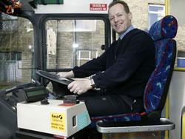
Bob is buying a ticket.

Slide 8
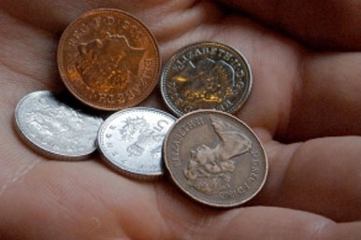
He is giving change to the driver.

Slide 9
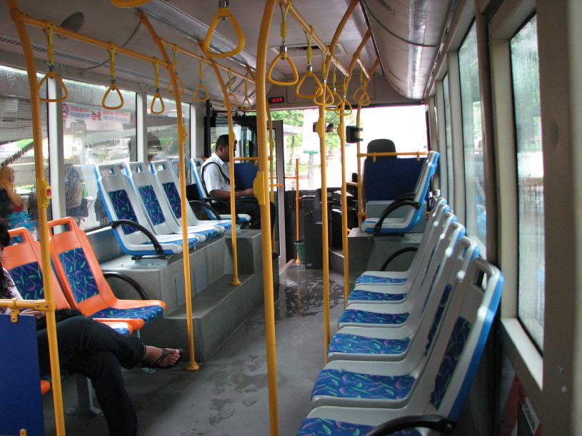
He is finding a seat.

Slide 10
He is sitting down.

Slide 11
The bus is leaving.

Slide 12
start again (if needed)
end show
slide 1

