Slide 1
Week 19 Leeds
end show
Notes:
Adapted from Nighat Butt

Slide 2
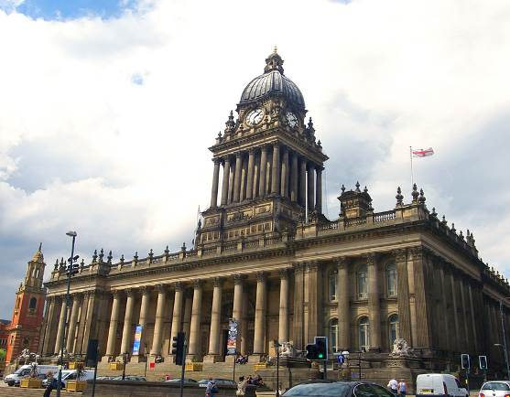
Leeds Town Hall

Slide 3
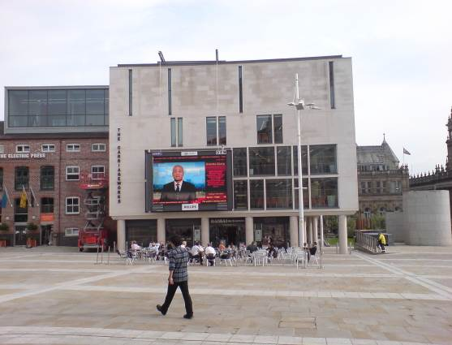
Millennium Square

Slide 4
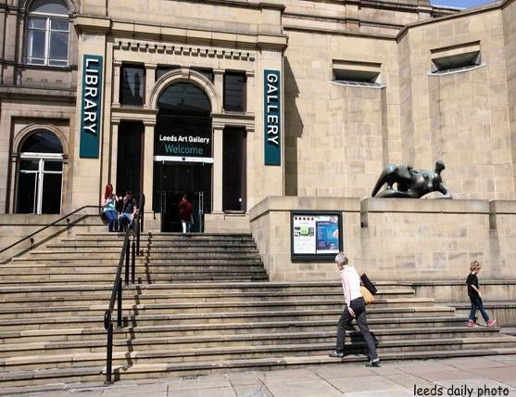
Leeds Art Gallery

Slide 5
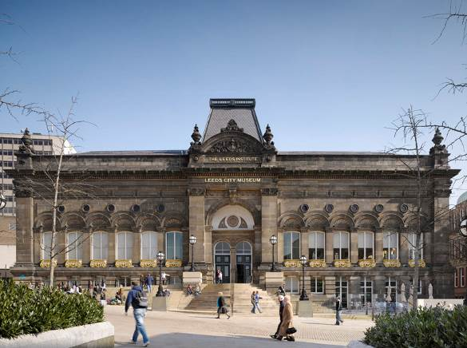
Leeds City Museum

Slide 6
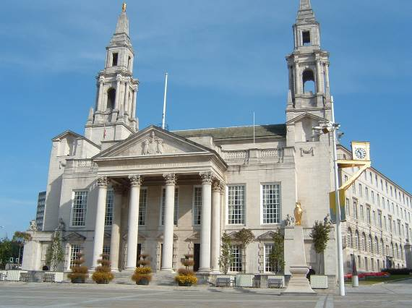
Leeds Civic Hall

Slide 7
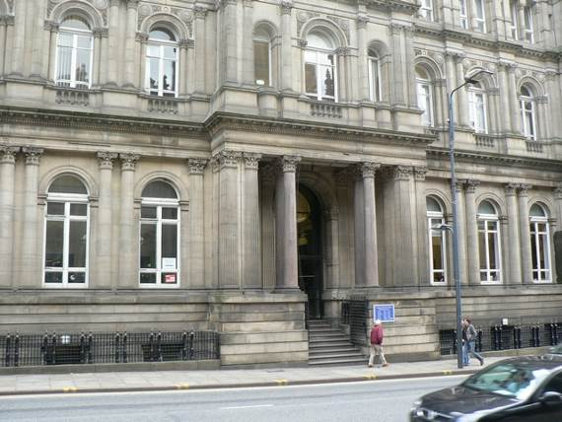
Leeds Central Library

Slide 8
start again (if needed)
end show
slide 1

