Slide 1
Week 18
Ideally, prior to showing these slides, print the slides and cut up the sentences and pictures. Ask the learners in groups to match them, then work through the slides and ask learners to correct as you go along.
Use the arrows on the keyboard to move forward or click the buttons. Press F5 on the keyboard to start the slideshow.
end show
Notes:
Prepositions of time and present simple tense
Prepositions of place

Slide 2
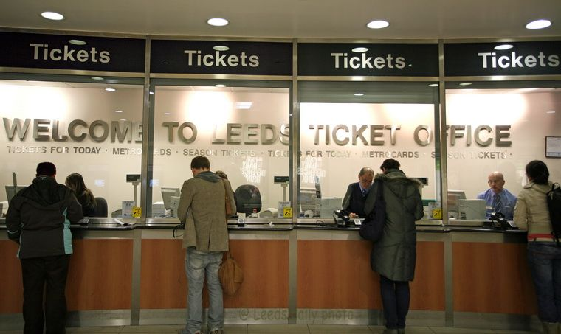
1
Hello. How can I help you?

Slide 3
How much is a single ticket to Bradford?

Slide 4
It’s £23 please.

Slide 5
What time is the train?

Slide 6
It leaves at 12.35.

Slide 7
Hello. How can I help you?

Slide 8
How much is a return ticket to Newcastle please?

Slide 9
That’s £57.50 please.

Slide 10
What time is the train?

Slide 11
It leaves at 13.11

Slide 12
start again (if needed)
end show
slide 1

