Slide 1
Week 17 Dining In – Lesson One

Slide 2
Breakfast

Slide 3
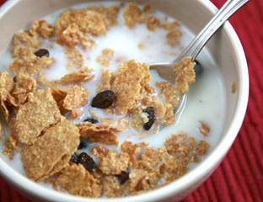
a bowl of cereal and milk

Slide 4
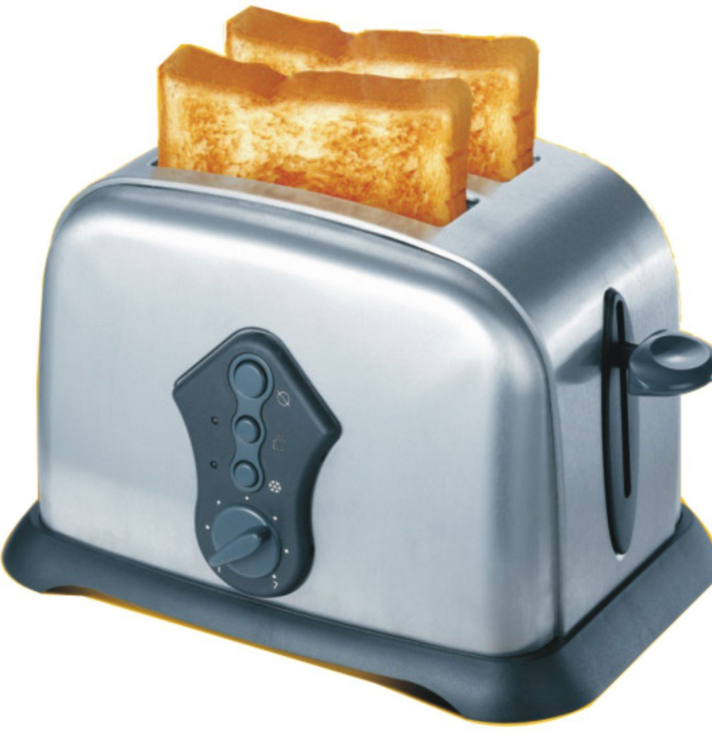
A slice of toast

Slide 5
A boiled egg

Slide 6
Lunch

Slide 7
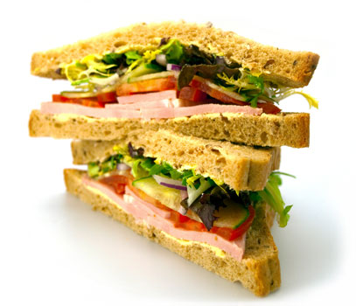
A sandwich

Slide 8
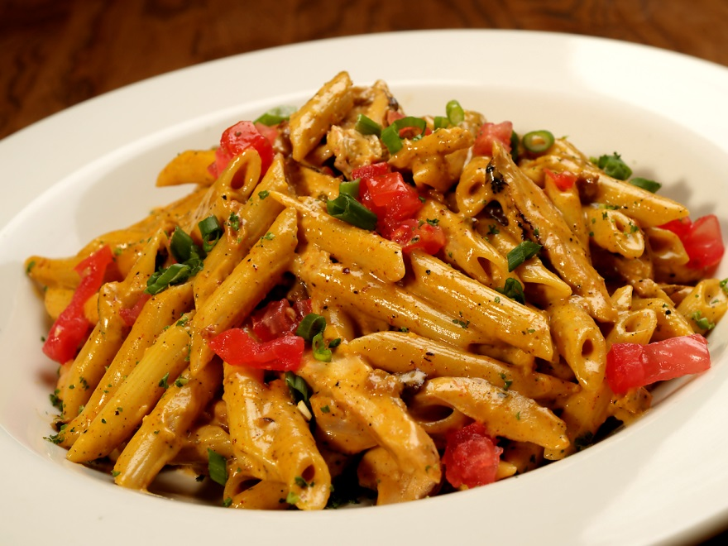
Pasta

Slide 9
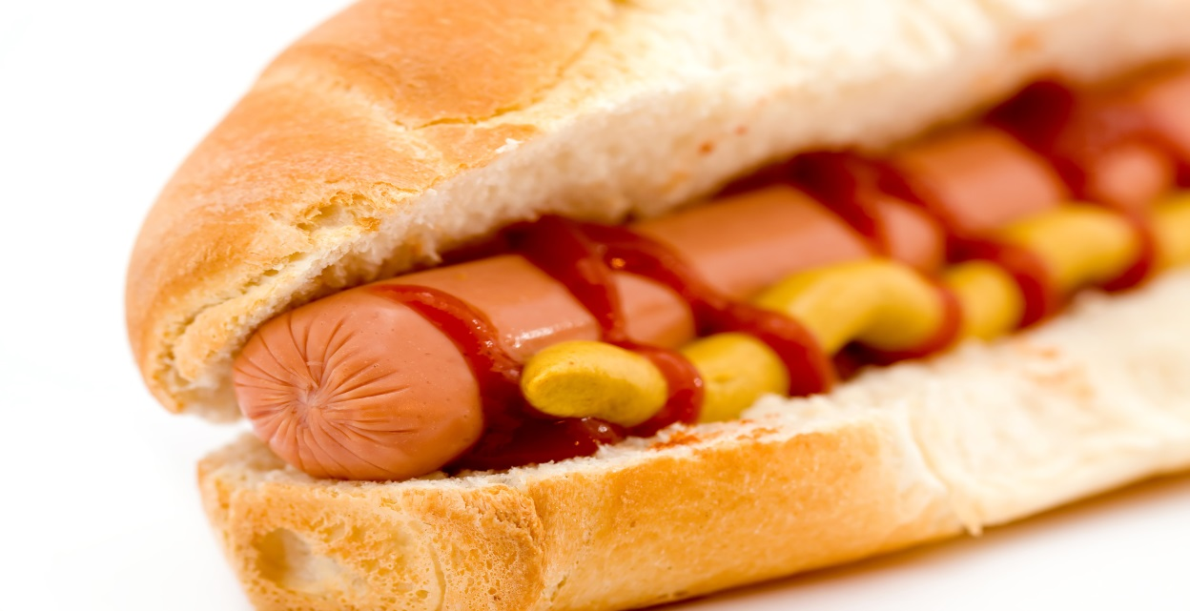
A hot dog

Slide 10
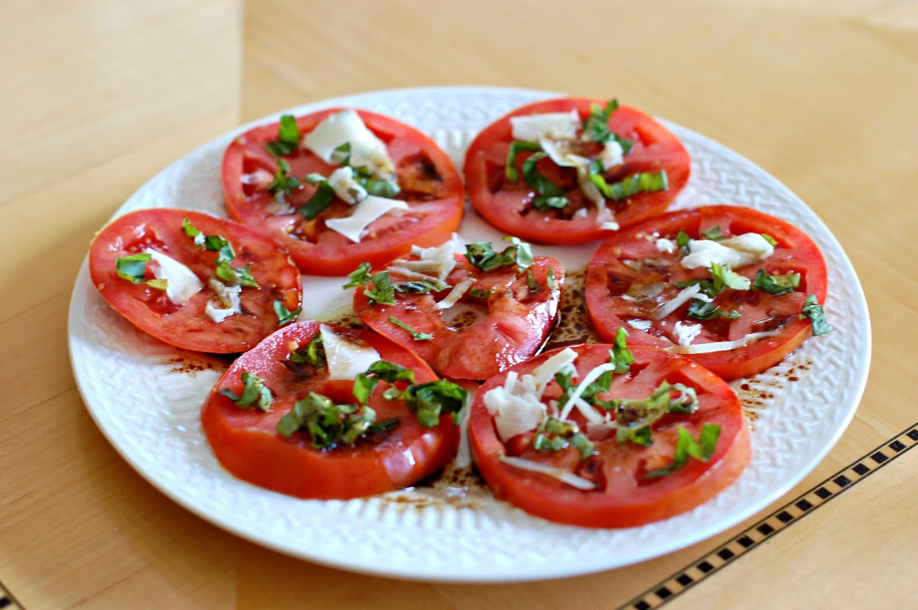
A tomato salad

Slide 11
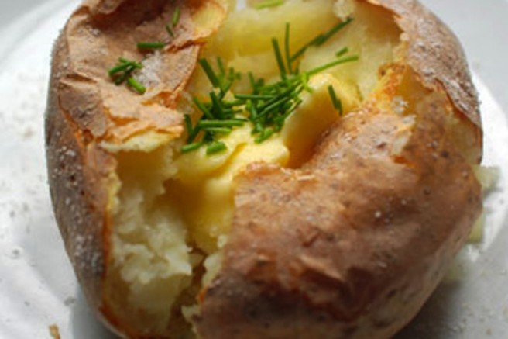
A jacket potato

Slide 12
Snack

Slide 13
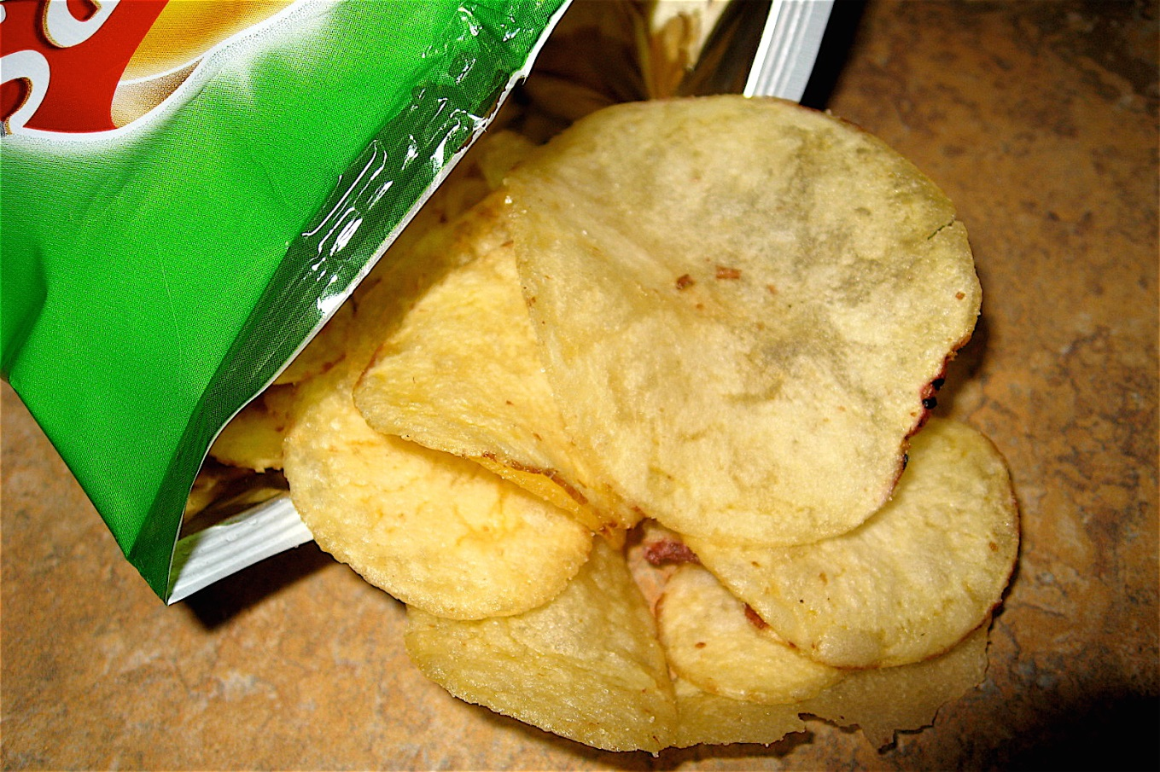
A packet of crisps

Slide 14
A piece of fruit

Slide 15
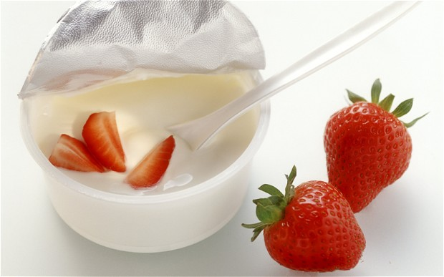
A pot of strawberry yoghurt

Slide 16
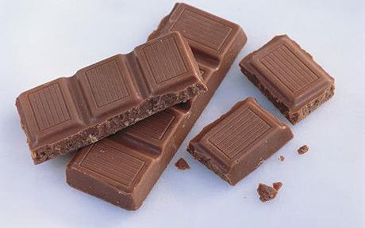
A bar of chocolate

Slide 17
Drinks

Slide 18
A glass of wine

Slide 19
A glass of orange juice

Slide 20
A cup of tea

Slide 21
A cup of coffee

Slide 22
Can you name the people ?

Slide 23
mother / mum
father / dad
granddad
grandma
son
daughter

Slide 24
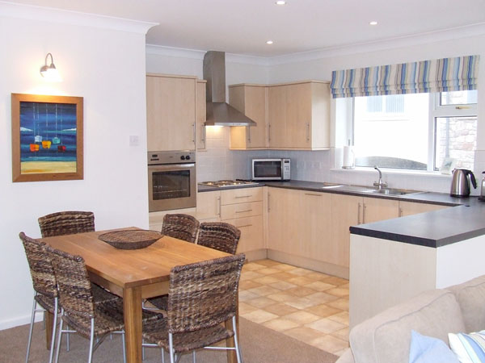
Dining room and kitchen

