Slide 1
Week 17
Ideally, prior to showing these slides, print the slides and cut up the sentences and pictures. Ask the learners in groups to match them, then work through the slides and ask learners to correct as you go along.
Use the arrows on the keyboard to move forward or click the buttons. Press F5 on the keyboard to start the slideshow.
end show
Notes:
Prepositions of time and present simple tense
Prepositions of place

Slide 2
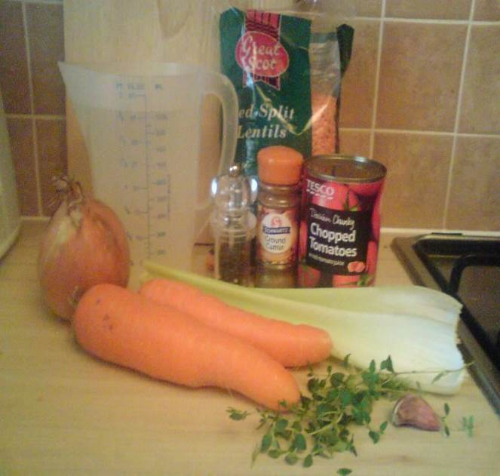
• 1 onion • 1 garlic • 2 celery • 2 carrots • 1 teaspoon cumin • 175g red lentils • 1.2 litres water • 1 can of tomatoes • pepper
Spicy Lentil Soup

Slide 3
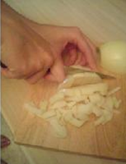
Chop the onion and garlic.
1

Slide 4
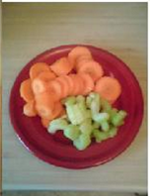
Slice the carrots and celery.
2

Slide 5
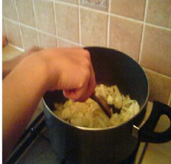
Fry the onion in a pan.
3

Slide 6
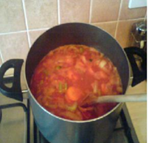
Add all the ingredients and stir.
4

Slide 7
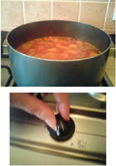
When the soup boils turn down the heat.
4

Slide 8
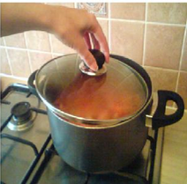
Cover for 25 minutes.
6

Slide 9
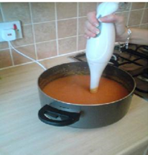
Blend the soup.
7

Slide 10
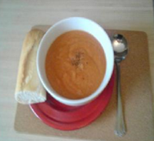
Eat with bread.
8

Slide 11
start again (if needed)
end show
slide 1

