Slide 1
Week 17
Ideally, prior to showing these slides, print the slides and cut up the sentences and pictures. Ask the learners in groups to match them, then work through the slides and ask learners to correct as you go along.
Use the arrows on the keyboard to move forward or click the buttons. Press F5 on the keyboard to start the slideshow.
end show
Notes:
Prepositions of time and present simple tense
Prepositions of place

Slide 2
What does Dad have for breakfast?
1

Slide 3
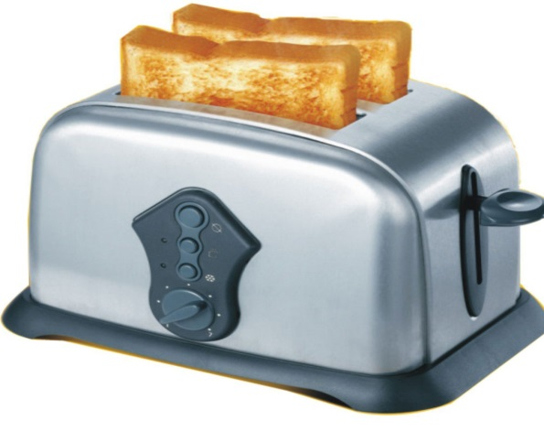
He has a slice of toast.
2

Slide 4
What does Mum have for lunch?
3

Slide 5
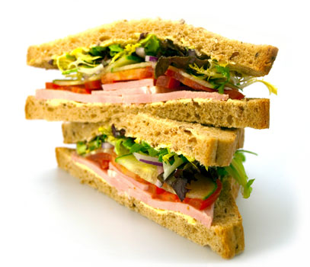
She has a sandwich.
4

Slide 6
What does their daughter have for a snack?
5

Slide 7
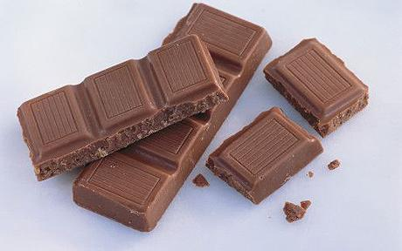
She has a bar of chocolate.
6

Slide 8
What does Granddad have to drink?
7

Slide 9
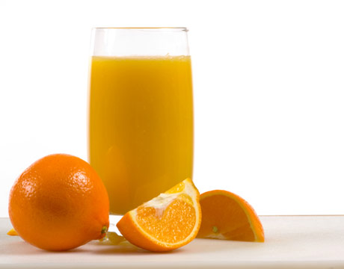
He has a glass of juice.
8

Slide 10
What does their son have for lunch?
9

Slide 11
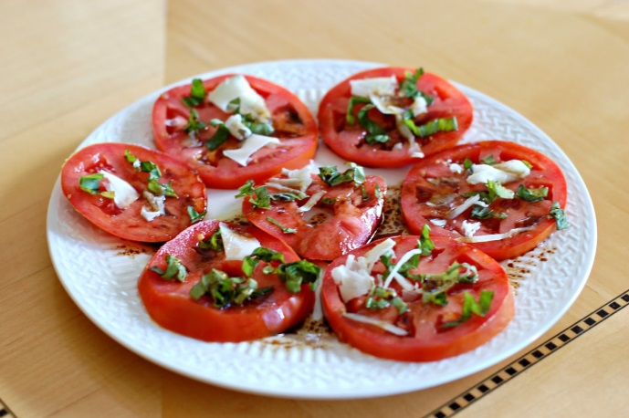
He has a tomato salad.
10

Slide 12
start again (if needed)
end show
slide 1

