Slide 1
Week 16 Dining Out
end show
Notes:
Adapted from Nighat Butt

Slide 2
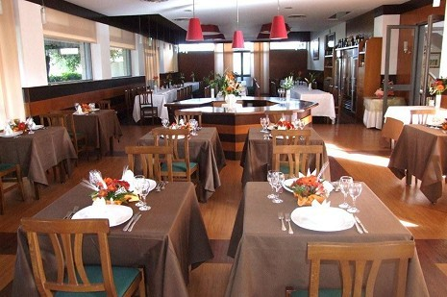
chair
lights
table
table cloth
Glasses
Flowers
knife and fork
Plate

Slide 3
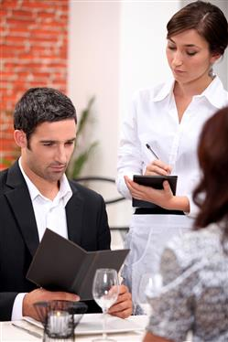
Menu

Slide 4
order

Slide 5
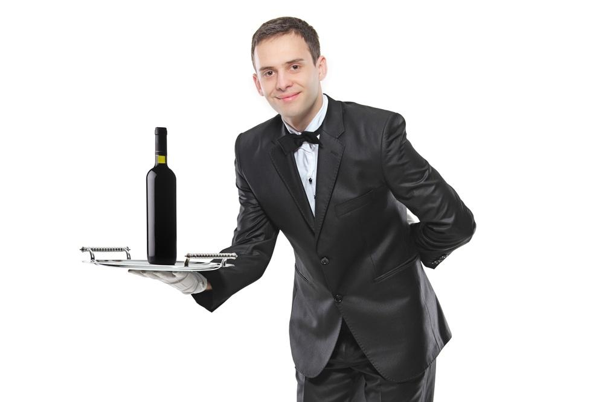
Waiter

Slide 6
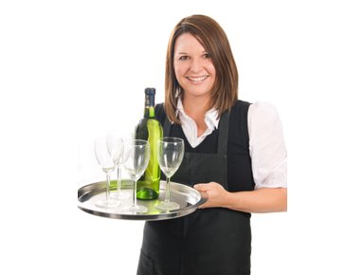
Waitress
Notes:
Created by Nighat Butt

Slide 7
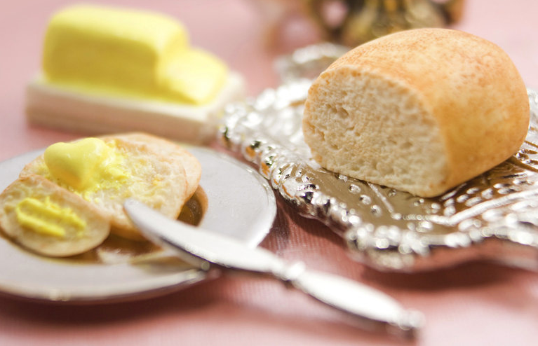
Starter
bread and butter

Slide 8
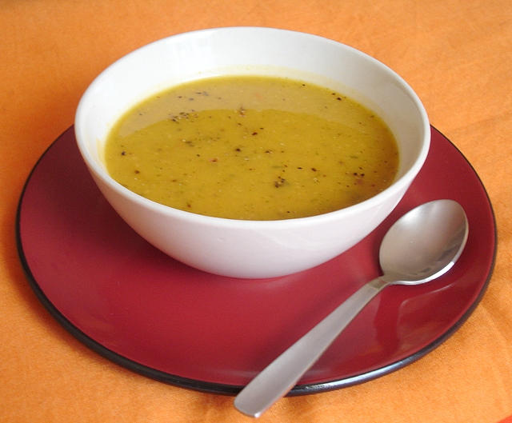
Starter
bowl of soup
Notes:
Created by Nighat Butt

Slide 9
starter
olives

Slide 10
Starter
salad

Slide 11
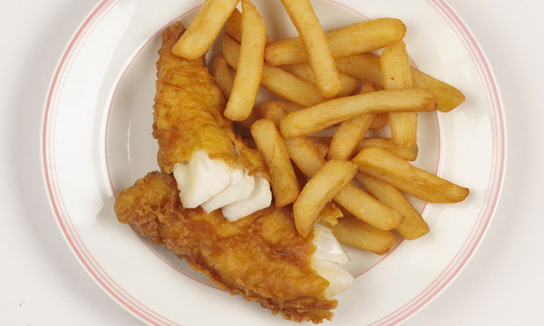
Main course
fish and chips

Slide 12
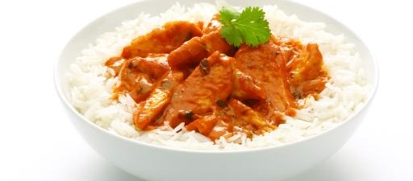
Main course
curry and rice

Slide 13
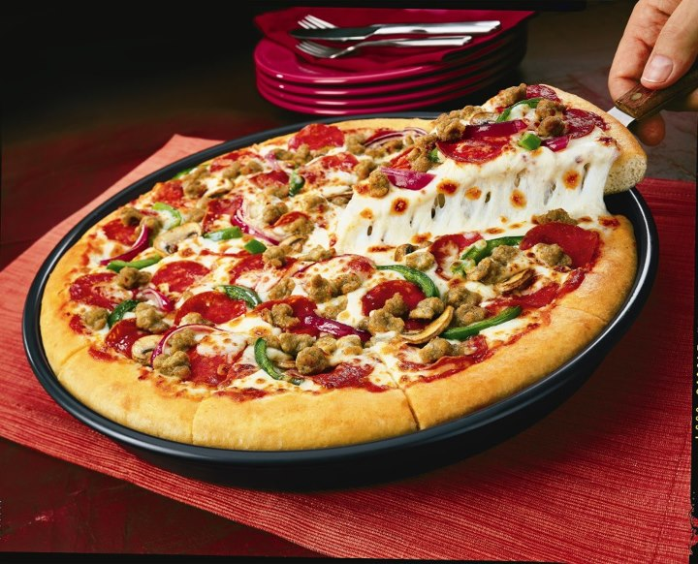
main course
pizza

Slide 14
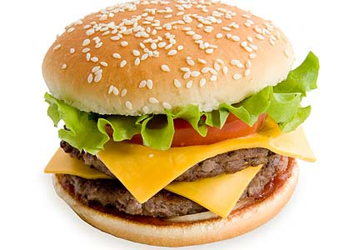
Main course
hamburger

Slide 15
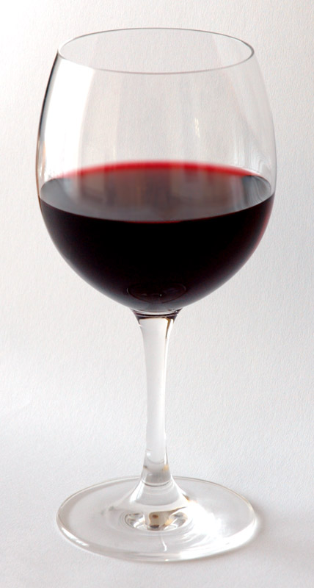
Drink
a glass of wine

Slide 16
Drink
pint of beer

Slide 17
Drink
glass of orange juice

Slide 18
Drink
glass of water

Slide 19
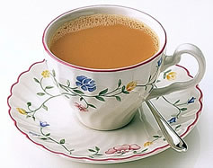
Drink
Cup of tea

Slide 20
start again (if needed)
end show
slide 1

