Slide 1
Week 15
Ideally, prior to showing these slides, print the slides and cut up the sentences and pictures. Ask the learners in groups to match them, then work through the slides and ask learners to correct as you go along.
Use the arrows on the keyboard to move forward or click the buttons. Press F5 on the keyboard to start the slideshow.
end show
Notes:
Prepositions of time and present simple tense
Prepositions of place

Slide 2
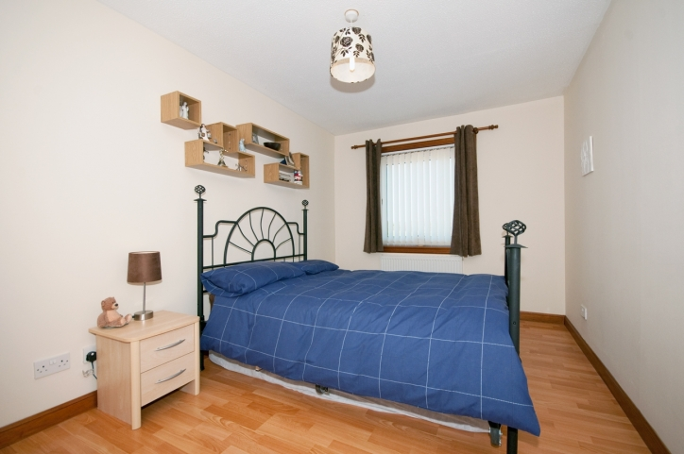
The shelves are above the bed.
1

Slide 3
The pillows are on the duvet.
2

Slide 4
The drawers are next to the bed.
3

Slide 5
The curtains are behind the bed.
4

Slide 6
The light is above the bed.
4

Slide 7
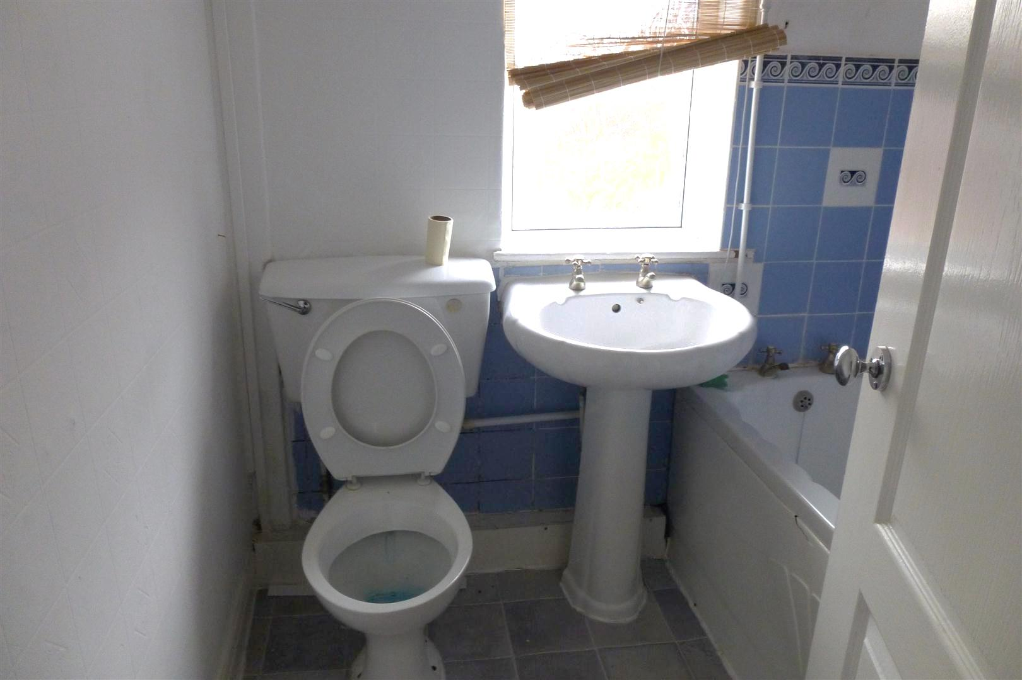
The blinds are above the sink.
6

Slide 8
The toilet paper is on top of the toilet.
7

Slide 9
The bath is behind the door.
8

Slide 10
The sink is next to the bath.
9

Slide 11
The tiles are on the wall.
10

Slide 12
start again (if needed)
end show
slide 1

