Slide 1
Week 15
Ideally, prior to showing these slides, print the slides and cut up the sentences and pictures. Ask the learners in groups to match them, then work through the slides and ask learners to correct as you go along.
Use the arrows on the keyboard to move forward or click the buttons. Press F5 on the keyboard to start the slideshow.
end show
Notes:
Prepositions of time and present simple tense
Prepositions of place

Slide 2
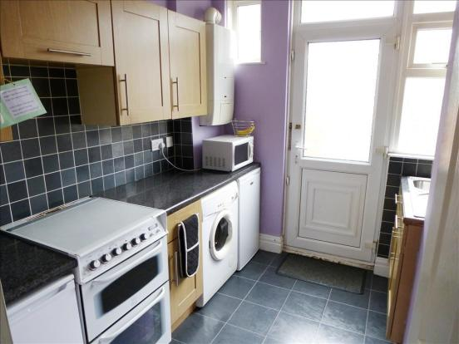
The microwave is above the fridge.
1

Slide 3
The oven gloves are in front of the cupboard.
2

Slide 4
The fridge is next to the washing machine.
3

Slide 5
The cupboards are on the wall.
4

Slide 6
The fridge is under the microwave.
5

Slide 7
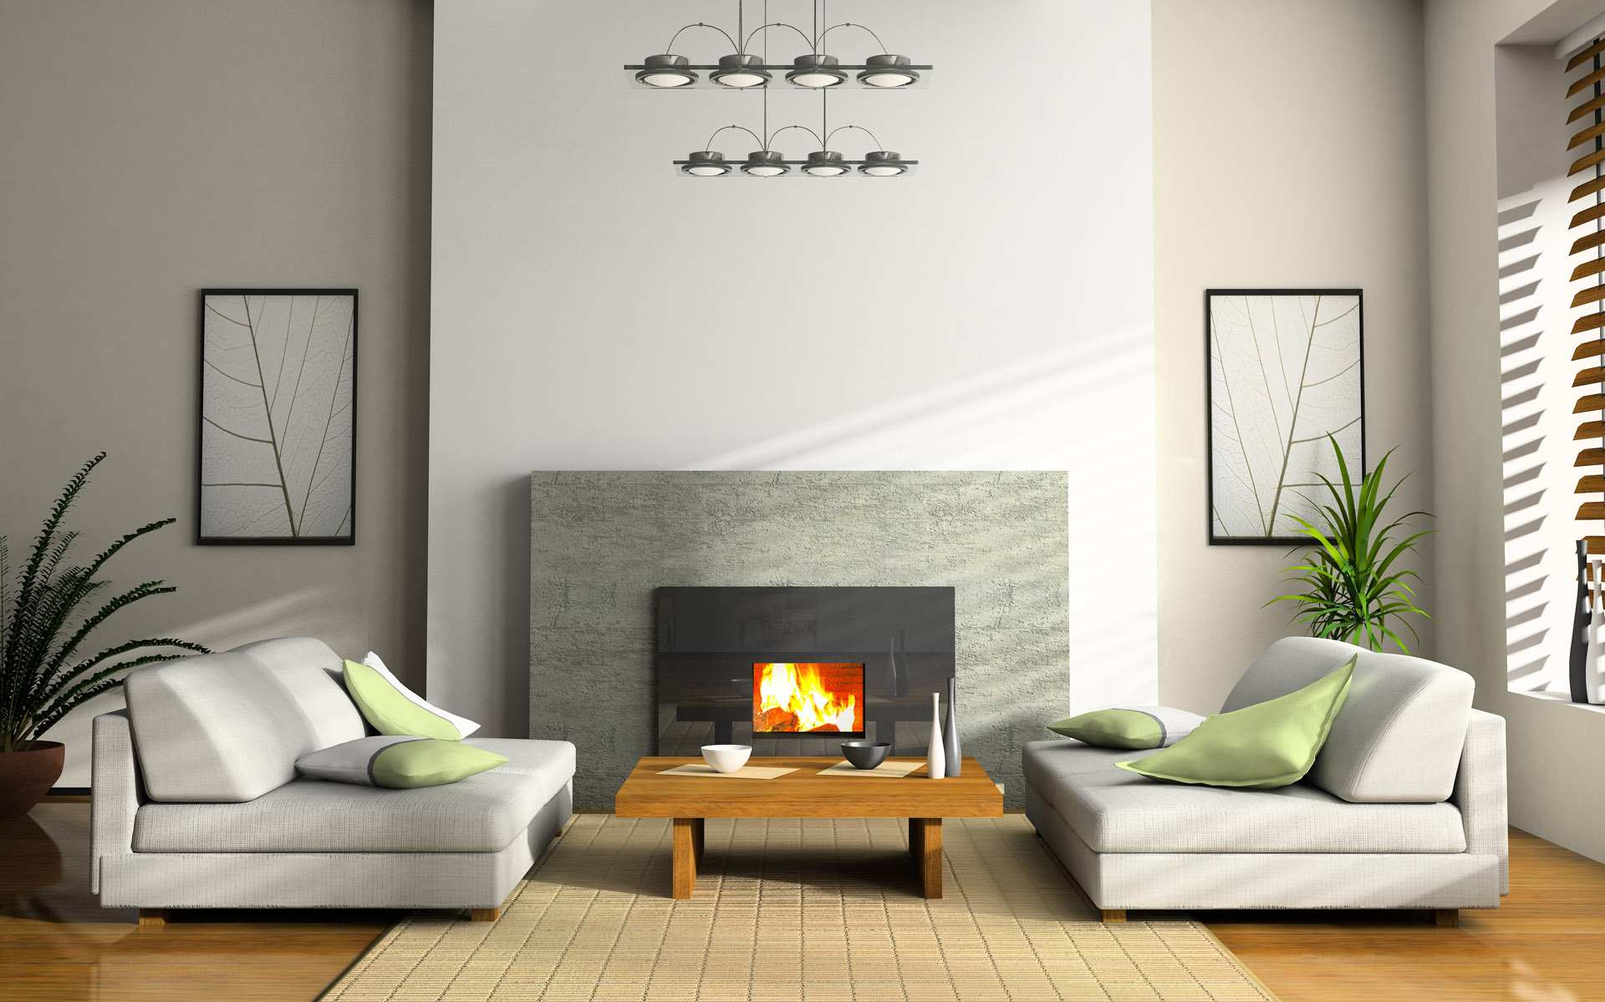
The rug is under the coffee table.
6

Slide 8
The plant is next to the sofa.
7

Slide 9
The fireplace is on the wall.
8

Slide 10
The coffee table is in front of the fire.
9

Slide 11
The lights are above.
10

Slide 12
start again (if needed)
end show
slide 1

