Slide 1
Week 14
Ideally, prior to showing these slides, print the slides and cut up the sentences and pictures. Ask the learners in groups to match them, then work through the slides and ask learners to correct as you go along.
Use the arrows on the keyboard to move forward or click the buttons. Press F5 on the keyboard to start the slideshow.
end show
Notes:
Prepositions of time and present simple tense
Prepositions of place

Slide 2
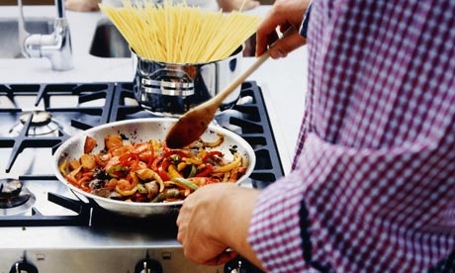
How often do you cook a meal?
1

Slide 3
I always do the cooking.
2

Slide 4
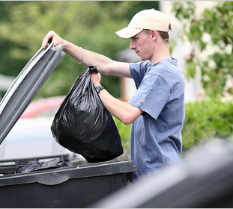
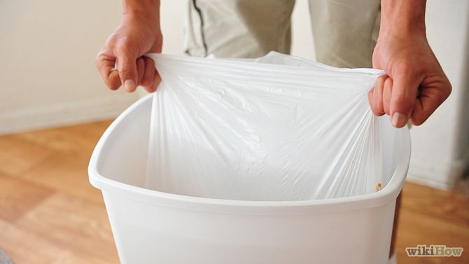
How often do you empty the bins?
3

Slide 5
I never empty the bins.
4

Slide 6
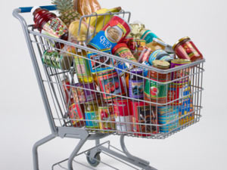
How often do you go shopping?
4

Slide 7
I sometimes go shopping.
6

Slide 8
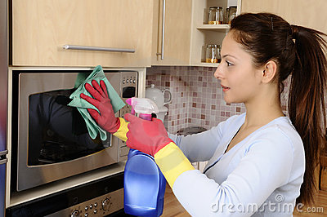
How often do you clean the house?
7

Slide 9
I usually clean the house.
8

Slide 10
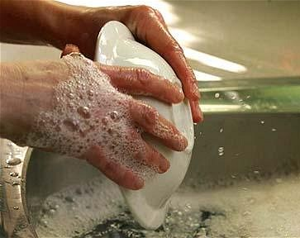
How often do you wash up?
9

Slide 11
I often wash up.
10

Slide 12
start again (if needed)
end show
slide 1

