Slide 1
Week 13
Ideally, prior to showing these slides, print the slides and cut up the sentences and pictures. Ask the learners in groups to match them, then work through the slides and ask learners to correct as you go along.
Use the arrows on the keyboard to move forward or click the buttons. Press F5 on the keyboard to start the slideshow.
end show
Notes:
Prepositions of time and present simple tense
Prepositions of place

Slide 2
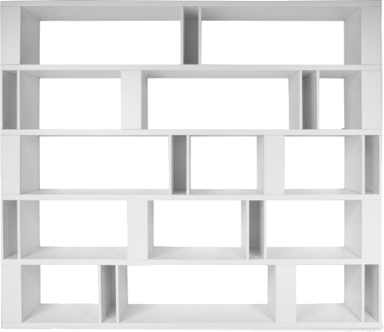
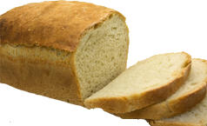
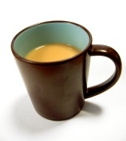
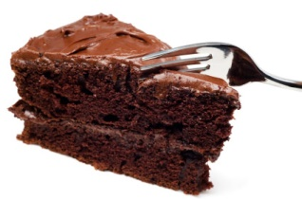
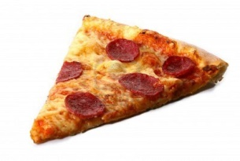
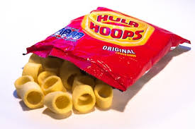
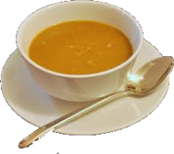
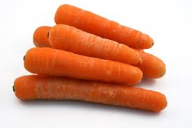

Slide 3
The bread is above the tea.
1

Slide 4
The cake is next to the tea.
2

Slide 5
The coffee is under the cake.
3

Slide 6
The pizza is on the shelf.
4

Slide 7
The crisps are between the pizza and the soup.
4

Slide 8
The water is in the glass.
6

Slide 9
The soup is next to the crisps.
7

Slide 10
The pizza is above the water.
8

Slide 11
The onions are in front of the carrots.
9

Slide 12
The carrots are behind the onions.
10

Slide 13
start again (if needed)
end show
slide 1

