Slide 1
Week 12
Ideally, prior to showing these slides, print the slides and cut up the sentences and pictures. Ask the learners in groups to match them, then work through the slides and ask learners to correct as you go along.
Use the arrows on the keyboard to move forward or click the buttons. Press F5 on the keyboard to start the slideshow.
end show
Notes:
Prepositions of time and present simple tense
Prepositions of place

Slide 2
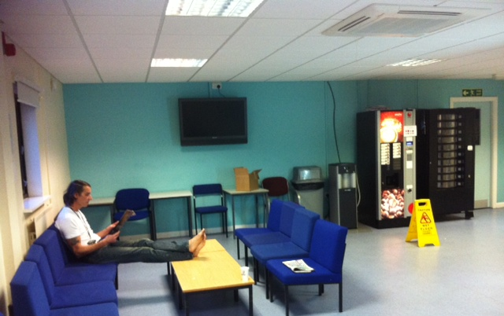
What is on the wall?
1

Slide 3
A TV.
2

Slide 4
Who is under the window?
3

Slide 5
The teacher.
4

Slide 6
Which table has a box?
5

Slide 7
The table next to the bin.
6

Slide 8
Where is the sign?
7

Slide 9
In front of the machine.
8

Slide 10
Where is the box?
9

Slide 11
Under the TV.
10

Slide 12
start again (if needed)
end show
slide 1

