Slide 1
Week 1 Where are you from?
Present one slide at a time, reading for the learners and getting them to mimic. Spell out CVC words using phonics, such as ‘good’ ‘from’ and standard letter sounds for Dolch words. Use this activity as a diagnostic, reading one letter at a time, asking them to repeat and say and write the letters on A4 paper, and to show you, then moving onto the words and pronunciation. Drill the words. Later building the words into sentences. After a length of drilling, hand out the worksheets and ask them to complete the first column, writing down each word as you say it.
Use the arrows on the keyboard to move forward or click the buttons. Press F5 on the keyboard to start the slideshow.
end show

Slide 2
good
10
8
6
5
4
3
1
2
7
9

Slide 3
morning
10
8
6
5
4
3
1
2
7
9

Slide 4
where
10
8
6
5
4
3
1
2
7
9

Slide 5
are
10
8
6
5
4
3
1
2
7
9

Slide 6
you
10
8
6
5
4
3
1
2
7
9

Slide 7
from
10
8
6
5
4
3
1
2
7
9

Slide 8
am
10
8
6
5
4
3
1
2
7
9

Slide 9
here
10
8
6
5
4
3
1
2
7
9

Slide 10
there
10
8
6
5
4
3
1
2
7
9

Slide 11
from
10
8
6
5
4
3
1
2
7
9

Slide 12
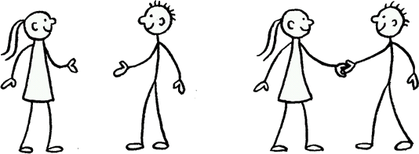
Good morning. Where are you from?
Good morning. I am from …

Slide 13
Where are you from?
I am from …

Slide 14
Hello. What is your name?
10
8
6
5
4
3
1
2
7
9

Slide 15
Hello. My name is …
10
8
6
5
4
3
1
2
7
9

Slide 16
start again (but faster)
end show
slide 1

